Slide 1

HRSA HAB EHE Overview
Boston Public Health Commission -
EHE Funded Subrecipient Agencies
June 6, 2023
Holly Berilla, EHE Project Officer
Eastern Branch, Division of Metropolitan HIV/AIDS Programs
HIV/AIDS Bureau (HAB)

Slide 2
HIV/AIDS Bureau Vision and Mission
Vision
Optimal HIV care and treatment for all to end the HIV epidemic in the U.S.
Mission
Provide leadership and resources to advance HIV care and treatment to improve health outcomes and reduce health disparities for people with HIV and affected communities.

Slide 3
Overview of Presentation
Today’s presentation will include:
An overview of the HRSA HAB Ending the HIV Epidemic in the U.S. (EHE) cooperative agreement,
A description of EHE services and allowable expenses,
EHE data reporting summary and resources,
An opportunity for questions/answers, and
A list of available resources and contacts.

Slide 4
Ending the HIV Epidemic in the U.S. (EHE) Initiative
Ending the HIV
Epidemic
Now is the time to end the HIV epidemic
We have access to the most powerful HIV
treatment and prevention tools in history and and we know where infections are rapidly spreading.
By equipping all communities at risk with these tools, we can end HIV
in America.

Slide 5
Background
This initiative began in FY 2020 to achieve the important goal of reducing new HIV infections to less than 3,000 per year by 2030.
Reducing new infections to this level will essentially mean that HIV transmissions would be rare and meet the definition of ending the epidemic.

Slide 6
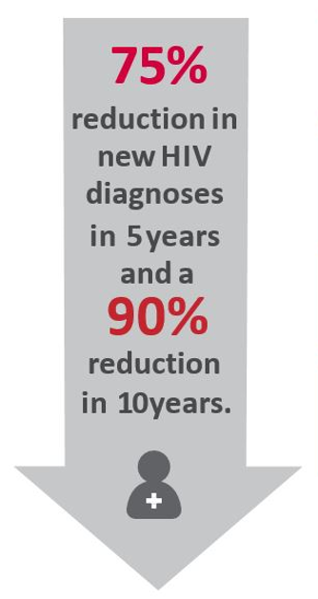




Four Pillars of EHE
Diagnose
  All people with HIV as early as possible.
Treat
  People with HIV rapidly and effectively to reach sustained viral suppression.
Prevent
  New HIV transmissions by using using proven interventions, including pre-exposure prophylaxis (PrEP) and syringe services programs (SSPs).
Respond
  Quickly to potential HIV outbreaks to get needed prevention and treatment services to people who need them.

Slide 7
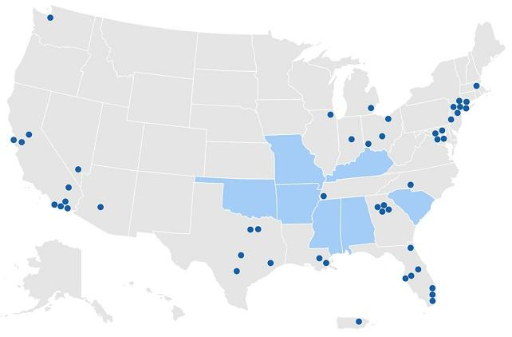
Geographic Locations of the Initiative
Efforts are focused in 48 counties, Washington, DC, and San Juan, PR, where more than 50% of HIV diagnoses occurred in 2016 and 2017, and seven states with substantial rural HIV burden.
County contributing to 50% new HIV diagnoses in 2016/2017
State with disproportionate rural burden in 2016/2017

Slide 8
HRSA HIV/AIDS Bureau Role
Jurisdictions
In February 2020, HRSA HAB was appropriated $70 million to Ryan White HIV/AIDS Program (RWHAP) recipients to link people with HIV to critical care and treatment services and provide workforce training and technical assistance.
  Ryan White HIV/AIDS Program Parts A and B
  Technical Assistance Provider
  Systems Coordination Provider
  AIDS Education and Training Center (AETC) Program for workforce capacity development
Implementing evidence-informed practices focused on those not yet diagnosed, those diagnosed but not in HIV care, and those who are in HIV care but not yet virally suppressed.
In March 2023, HRSA HAB was appropriated $165 million for FY 2023 HAB EHE recipients.
Community Engagement
Systems Coordination
TA and Capacity Building

Slide 9
Achieving the Ending the HIV Epidemic in the U.S. Goals
People with HIV in care
Improve viral suppression rates
Decrease disparities
People newly diagnosed with HIV
Enhance linkage to care
Enhance engagement in care
People with HIV out of care
Expand re-engagement in care
Improve retention in care

Slide 10
Initiative Requirements
Expand access to HIV care and treatment in the focus jurisdictions for people with HIV who are:
  newly diagnosed,
  who are not engaged in care, and/or
  not virally suppressed
Address unmet needs and improve client-level health outcomes
Reduce disparities
Respond quickly to HIV cluster detection efforts for those people with HIV who need HIV care and treatment

Slide 11
Initiative Requirements (cont.)
Use these initiative resources in conjunction with the RWHAP Parts A and B systems of HIV care and treatment to develop, implement, and/or enhance innovative approaches to engaging people with HIV who are newly diagnosed, not in care, and/or not virally suppressed
Recipients will provide rapid access to a comprehensive continuum of high-quality care and treatment services
Collaborate with HRSA’s Technical Assistance Provider (TAP-In) and Systems Coordination Provider (SCP)

Slide 12
Examples of Funded Activities
Increase organizational capacity
Disseminate information and conduct public outreach
Engage the community
Implement emerging practices
Develop and implement evidence-informed and/or evidenced-based interventions, particularly around linkage to care, retention in care, reengagement in care, and adherence counseling
Provide needed client services including those within and external to RWHAP service categories (PCN 16-02)
Develop data infrastructure and systems linkages

Slide 13
RWHAP and EHE Crosswalk –Eligibility & Allowable Costs
Requirement | RWHAP | EHE Initiative
Eligibility | HIV Positive and Low-income | HIV Diagnosis
Payor of Last Resort | Required | Required
Allowable Costs | Core Medical Services | Core Medical Services
 | Support Services | Support Services
 |  | Initiative Services and Infrastructure
 | Administrative/Planning and Evaluation | Administration/Planning and Evaluation
 | CQM | CQM
Recertification of Eligibility | Required, every six months; by policy | Not Required

Slide 14
RWHAP and EHE Crosswalk – Distribution of Funds
Requirement | RWHAP Policy | EHE Initiative
75/25 | 75% of grant for Core Medical Services | Not Required
Administrative Costs Cap | Administrative - 10% Planning and Evaluation - 10% Collectively - 15% CQM - Not to exceed 5% or $3M | Administrative - 10% Planning and Evaluation - 10% Collectively - 15% CQM - up to 5%
Imposition of Charges | For eligible individuals >100% FPL | Not Required
Unobligated Balance Penalty/75% Obligated | Required | Not Required
Maintenance of Effort/ State Match | Required | Not Required

Slide 15
RWHAP and EHE Crosswalk – Other
Requirement | RWHAP Policy | EHE Initiative
Medicaid Provider, as Appropriate | Part A – Required by Statute Part B – Required by Policy | Required
Planning/Comprehensive Plan | Part A – Planning Council Prioritizes Allocation of Funds & Comprehensive Plan Required Part B – Comprehensive Plan Required | Not Required
Community Engagement | Required | Expected
Program Income | For the purposes under which the award was made; additive | Used for approved project related activities; additive

Slide 16
EHE Initiative & Ryan White HIV/AIDS Program Services
Initiative Services
  Costs associated with a broader approach to addressing HIV in the community than exists in services authorized by the RWHAP legislation.
  Initiative services (e.g., linkage to care) are services and activities that do not fit neatly within the RWHAP service categories.
  These services may be innovative and creative with a focus on ending the HIV epidemic.
  In some instances, prior approval is needed.
Ryan White HIV/AIDS Program (RWHAP) Services
  Costs associated with the provision of core medical and support services to initiative eligible clients.
  Services must relate to HIV diagnosis, care, and support, and follow established clinical practice standards consistent with HHS HIV treatment guidelines.
  Must comply with PCN 16-02.

Slide 17
EHE Infrastructure
Infrastructure
  Costs associated with the development and expansion of data systems.
    Infrastructure may include technical assistance on the type, design, and building of new data systems, bridging existing systems to achieve data integration, improving data entry to decrease burden and increase accuracy, training of staff and providers on collecting and using data, and employing experts to provide accurate and in-depth data analysis.
  Note: There is no spending limit on infrastructure.

Slide 18
EHE Administration and Planning & Evaluation
Administration - Costs associated with the administration of the initiative cooperative agreement.
  No more than 10 percent of the initiative budget can be spent on administrative costs, including indirect costs.
  Staff activities that are administrative in nature allocated to administrative costs.
  The aggregate total of administrative expenditures for subrecipients, including indirect costs, may not exceed 10 percent of the aggregate amount of all subawards.
Planning and Evaluation - Costs associated with stakeholder engagement and process and outcome evaluation activities.
  No more than 10 percent of the initiative budget can be spent on planning and evaluation costs.
NOTE: Administration and planning & evaluation costs, combined, cannot exceed 15 percent of the total award.

Slide 19
EHE Clinical Quality Management
Clinical Quality Management (CQM)
  EHE recipients are not required to fund CQM.
  CQM is used to assess the extent to which services are consistent with the current HHS guidelines for the treatment of HIV and to develop strategies to improve access to and quality of services.
  Please note the difference between quality improvement, quality assurance, and what is considered to be grants administration activities when allocating funds to CQM:
    Quality improvement - developing and implementing activities to improve care, health outcomes, and satisfaction. Costs can be allocated to the CQM cost category.
    Quality assurance - part of a larger grants administration function and informs the CQM program. Considered administrative and costs cannot be allocated to CQM.
  See Policy Clarification Notice 15-02: Clinical Quality Management or your EHE project officer.
NOTE: CQM cannot exceed 5 percent of the total award.

Slide 20
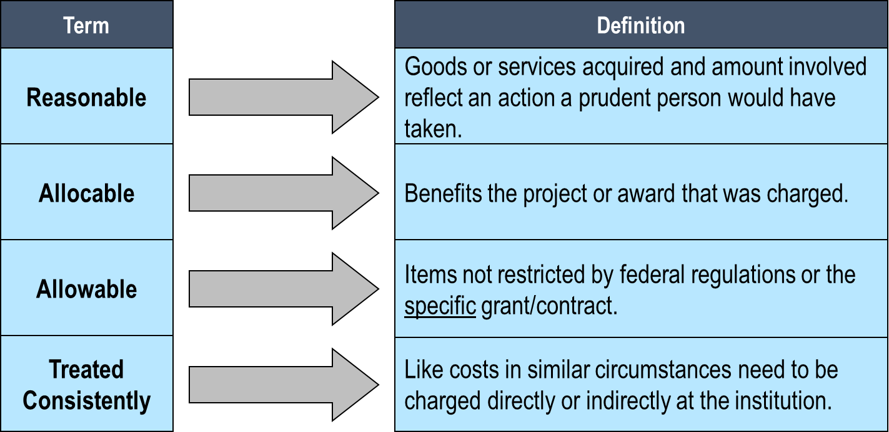
Cost Principles
Federal requirements flow down to the subrecipient level. The following cost principles apply to all federal awards:

Slide 21
Unallowable Costs
Ensure that the EHE award is the payor of last resort and continue, to vigorously pursue other sources of payment or resources.
Unallowable costs – No difference between EHE-funded core medical and support services and that of the RWHAP. Funds may not be used to make cash payments to intended clients of HRSA RWHAP-funded services, including cash incentives or gift cards, tickets, coupons, etc. that can be exchanged for cash.
EHE Initiative Services (cost category), however, allows programs to stretch beyond the boundaries of traditional RWHAP to creatively meet EHE goals.
The list of unallowable costs are listed in PCN 16-02 and the HRSA SF-424 Application Guide.
https://ryanwhite.hrsa.gov/sites/default/files/ryanwhite/grants/service-category-pcn-16-02-final.pdf

Slide 22
EHE-Specific Reporting
EHE funded providers are to complete the:
Triannual Data Report
  Submitted three times per year.
  Includes aggregate data on clients with HIV that received a direct service during the reporting period, regardless of payor or RWHAP eligibility.
  Includes services for which funding was received from one or more of the following:
    EHE Initiative – including carryover
    RWHAP grant funds
    Program income and pharmaceutical rebates
Annual RSR
https://targethiv.org/sites/default/files/media/documents/2022-12/EHE-Data-Reporting-In-Focus-12-22_DISQ.pdf

Slide 23
Triannual Data Report
The EHE Triannual Report collects aggregate-level data on all clients with HIV who received a service during the reporting period regardless of funding source or RWHAP eligibility.
For example, a client with HIV who is not eligible for the RWHAP may still receive services funded by EHE. Therefore, if this client received services from an EHE-funded provider during the reporting period, they should be included in the EHE Triannual Report
Please note, all clients served using EHE funding must be reported in Client-Level Data Report (CLD) in the RSR.
https://targethiv.org/sites/default/files/media/documents/2022-12/EHE-Data-Reporting-In-Focus-12-22_DISQ.pdf

Slide 24
Ryan White Services Report
All clients reported in the EHE Triannual Report are to be included in the RSR.
While only HAB EHE service providers are required to report clients in the EHE Triannual Report, service providers funded by RWHAP, RWHAP-related (program income or pharmaceutical rebates), FY 2020 CARES Act, and EHE sources must submit client data for the RSR.
https://targethiv.org/sites/default/files/media/documents/2022-12/EHE-Data-Reporting-In-Focus-12-22_DISQ.pdf

Slide 25
HELP is available!
Please refer to the following resources on TargetHIV:
Ending the HIV Epidemic (EHE) Triannual Report - Instruction Manual
Recorded webinars, FAQs, and other resources for your reference.
  https://targethiv.org/sites/default/files/media/documents/2022-09/List_of_Mentioned_Resources__EHE_Triannual_PROVIDER_Report.pdf
  https://targethiv.org/sites/default/files/media/documents/2022-09/20220912_CompletingtheEHETriannualProviderReportWebinar_508_DSTA_DISQ.pdf
  https://targethiv.org/library/ending-hiv-epidemic-ehe-triannual-report-faq
  Also, HRSA HAB technical assistance providers are available…

Slide 26
Data Support Contacts
Ryan White HIV/AIDS Program Data Support – for help deciphering the EHE Triannual Report Instruction Manual, reporting requirements, and allowable data element responses; system issues - resolving warnings/errors; & submitting your provider report.
Contact: 1-888-640-9356, RyanWhiteDataSupport@wrma.com
Data Integration, Systems & Quality (DISQ) Team - for help with planning how to collect & report data, extracting data from your electronic health record or other data management system, mapping data to required data elements, and developing data collection, management, quality, and utilization processes.
Contact: Data.TA@caiglobal.org or www.targetHIV.org/disq

Slide 27
Resources
EHE Initiative websites
  HIV.gov - https://www.hiv.gov/federal-response/ending-the-hiv- epidemic/overview
  HRSA - https://www.hrsa.gov/ending-hiv-epidemic
  CDC - https://www.cdc.gov/endhiv/index.html
  Federal award-related resources
    HRSA HAB Policies (Policy Clarification Notices (PCNs) and Program Letters)
    EHE 20-078 NOFO: https://grants.hrsa.gov/2010/Web2External/Interface/Common/EHBDisplayAttachment.aspx?dm_rtc=16&dm_attid=8da9bb78-c8a5-46e8-9afa-a461f44ad602
    RWHAP Legislation: Ryan White HIV/AIDS Program Legislation | Ryan White HIV/AIDS Program (hrsa.gov)
    HHS Grants Policy: HHS Grants Policy Statement (the General Terms for all HAB recipients)
    RWHAP Part A Manual: Part A Manual (hrsa.gov)
  Other
    TargetHIV: https://targethiv.org/

Slide 28
Questions?

Slide 29






Connect with HRSA
Learn more about our agency at:
www.HRSA.gov
Sign up for the HRSA eNews
FOLLOW US:

