Slide 1
613 MASS AVE REAR DECK UPGRADES _______________ REQUESTING APPROVAL FOR SEASONAL POLE BRACKETS AND DECK BOARDS REPLACED WITH COMPOSITE

Slide 3
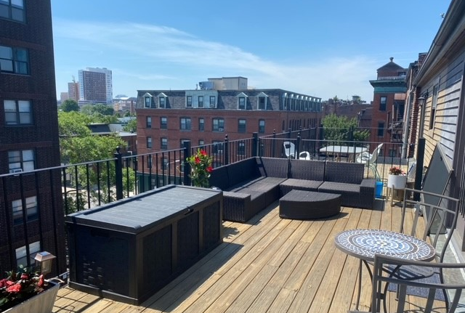
WE ARE NOT REMOVING HANDRAILS JUST REPLACING EXISTING AGED WOODEN DECK BOARDS WITH TREX COMPOSITE. INSTALLING A BLACK METAL BRACKET TO CORNER POSTS OF THE DECK SO OWNER CAN SLIDE A POLE IN THERE TO STRING LIGHTS FROM DURING THE SUMMER MONTHS.
EXISTING CONDITIONS

Slide 4
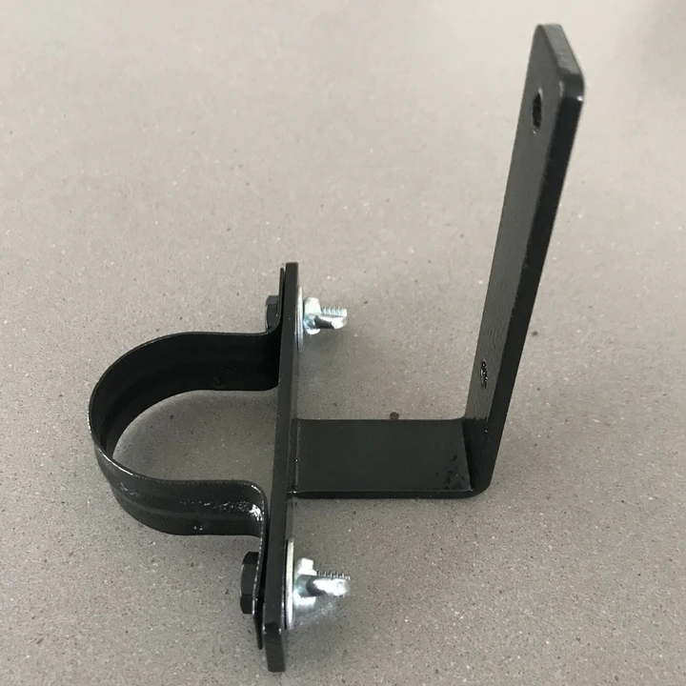
BELOW IS AN EXAMPLE OF WHAT THE SEASONAL POLES WILL LOOK LIKE PLEASE NOTE THE BRACKETS WILL BE ATTACHED TO THE EXISTING RAILINGS AND THE POLES SIMPLY SLIDE UP AND OUT THE POLES ARE NOT MECHANICALLY FASTENED IN PLACE

Slide 5
DECKING – WE ARE REPLACING THE EXISTING WOODEN DECK BOARDS WITH TREX SELECT COMPOSITE DECKING

Slide 6
THE DECK IS NOT VISIBLE FROM THE FRONT JUST FROM THE REAR AND SIDES

