Slide 1

6/16/2020
Crown Castle Small Cell Site
Lightpole in Front of 31 Park Dr. Boston, Ma
Boston Landmarks Commission

Slide 2
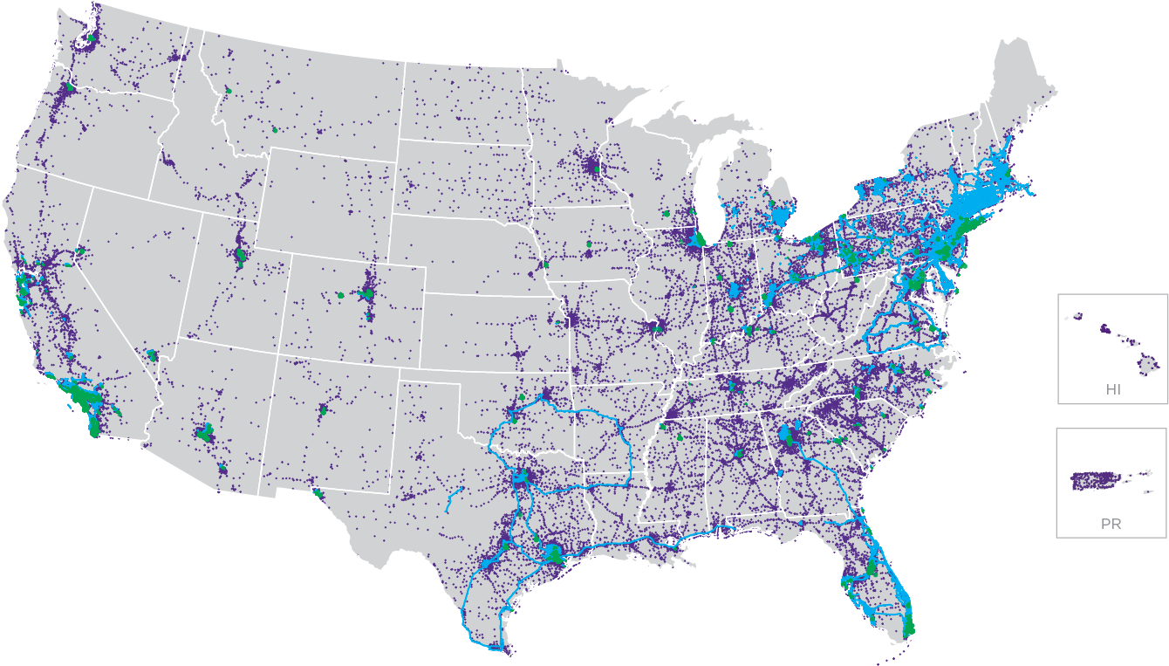
Crown Castle is the nation’s leading wireless infrastructure provide in Towers, Fiber and Small Cells
40,000+
towers
~70,000
small cells on air or under contract
~80,000
route miles of fiber

Slide 3

What are small cell solutions?
Small cell solutions (SCS) are a complement to towers that add much needed coverage and capacity to urban and residential areas, venues, and anywhere large crowds gather.
Antennas connected to nodes receive and transmit signal to and from smartphones
The cabinet holds equipment
that processes signal for
wireless operators
Optical fiber carries data to and from data centers, allowing a significant amount of bandwidth
3

Slide 4
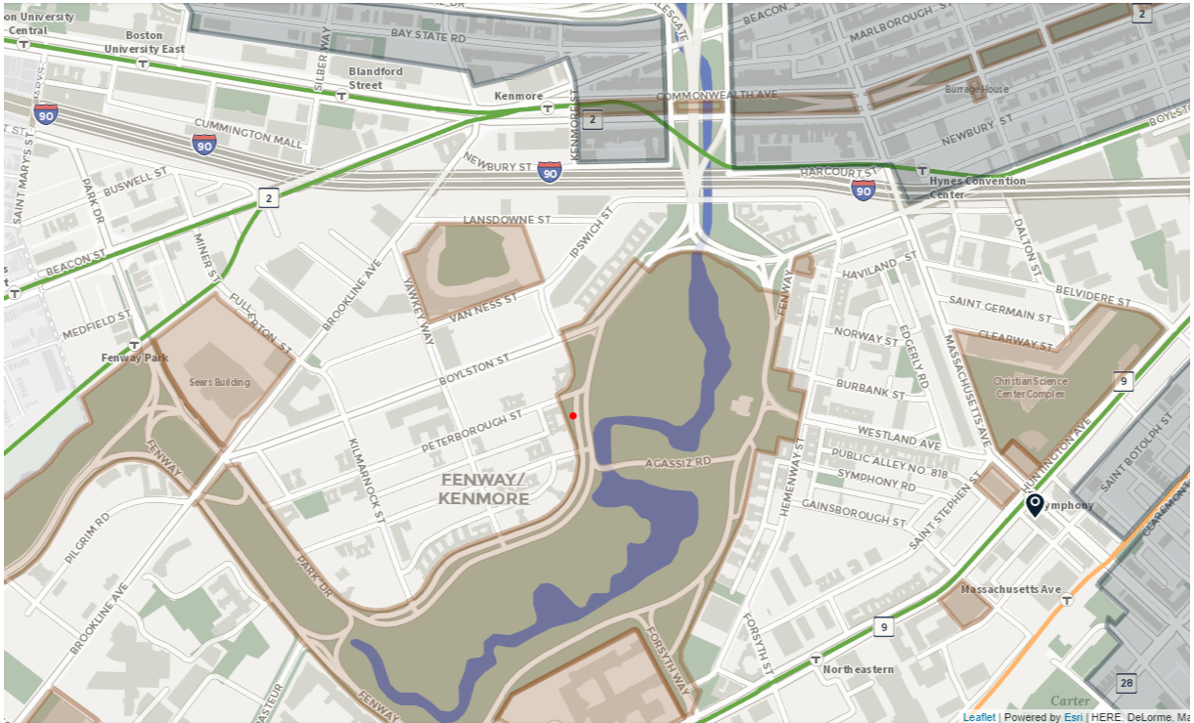

Slide 5
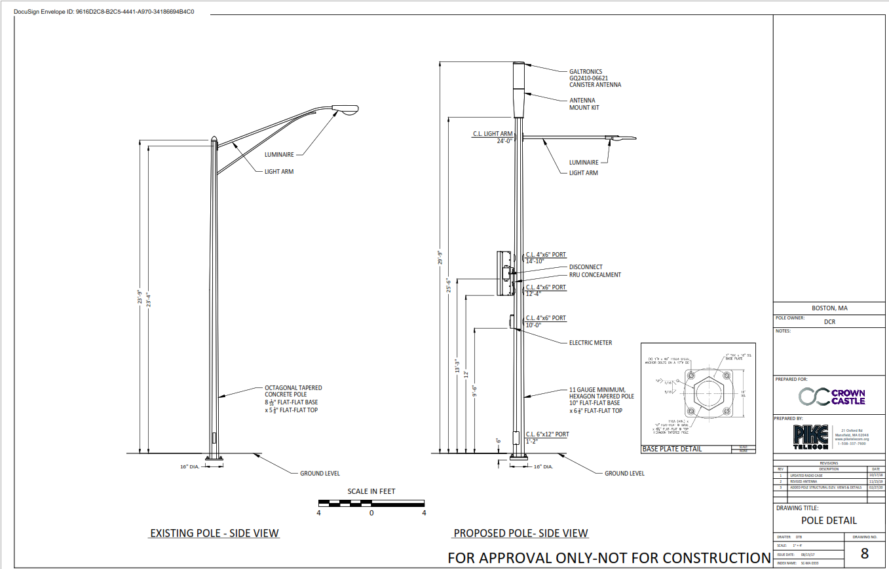

Slide 6
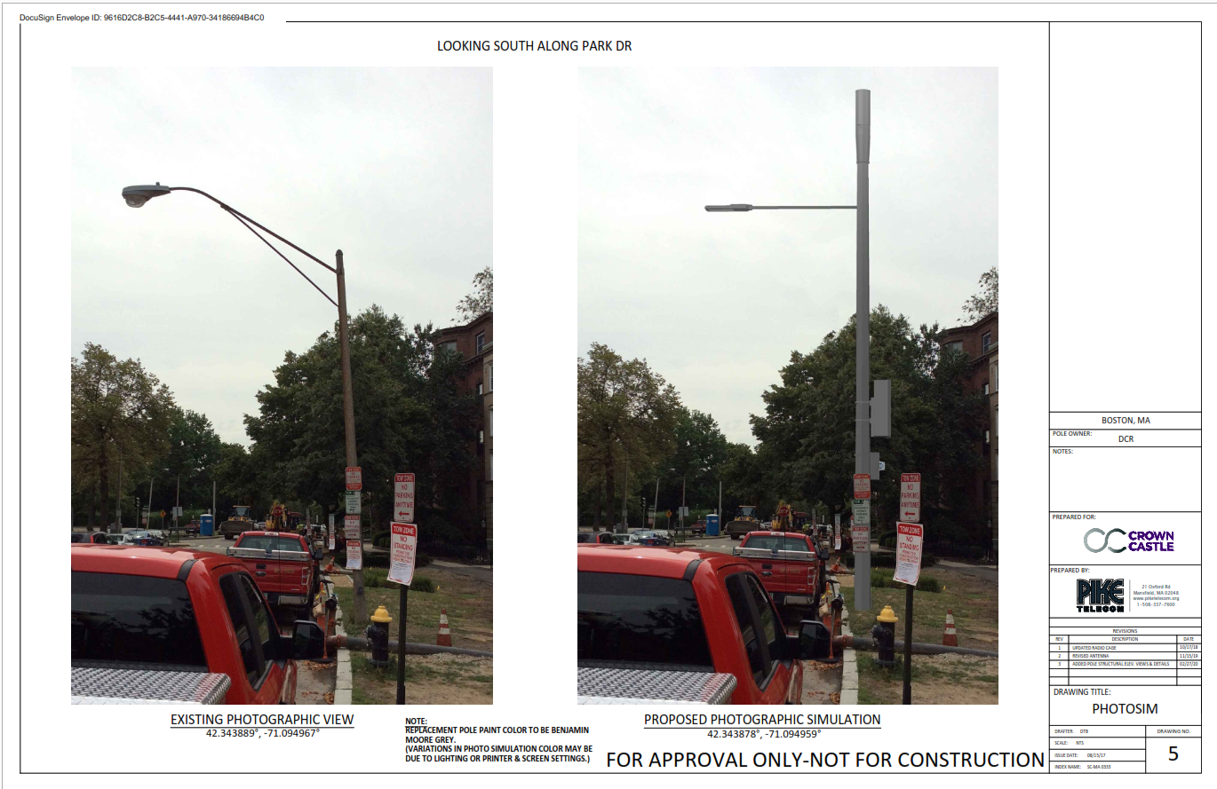

Slide 7
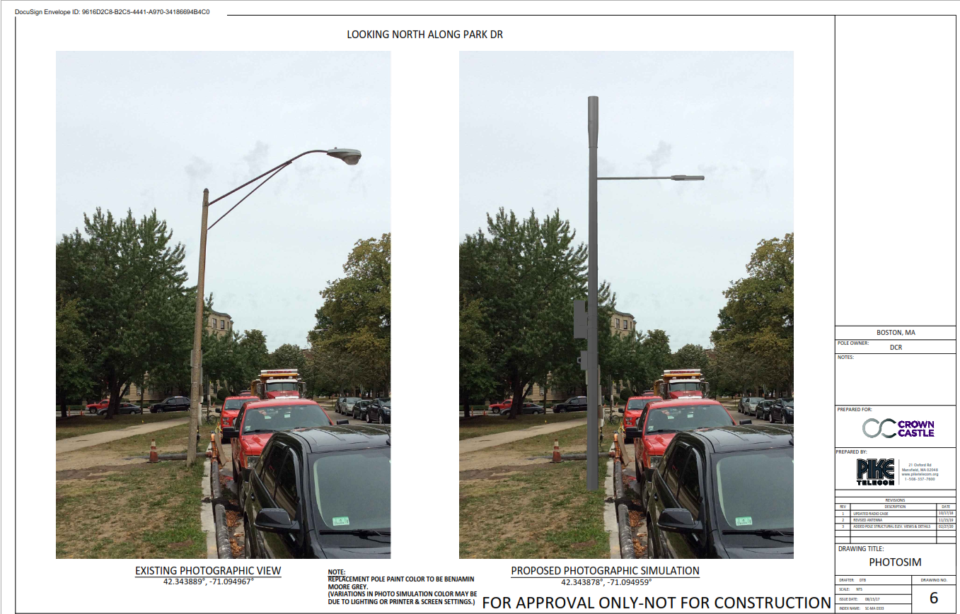

Slide 8
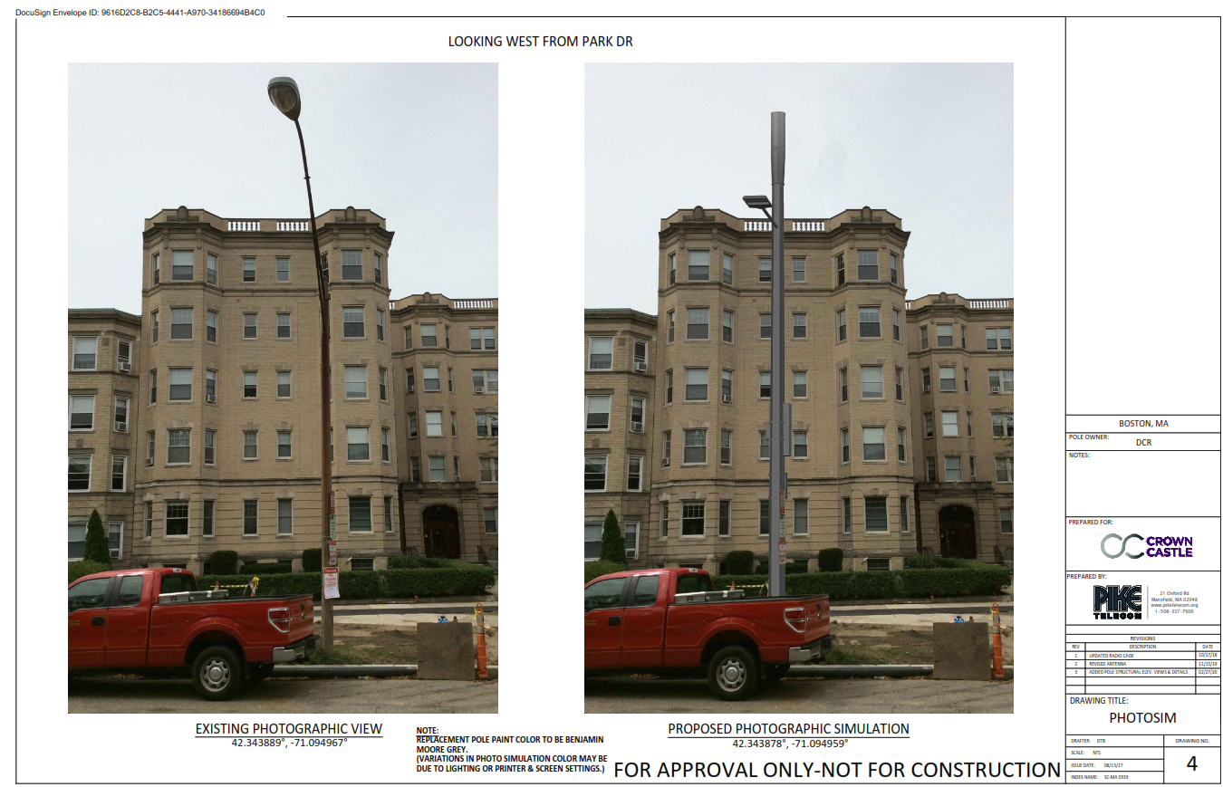

Slide 9
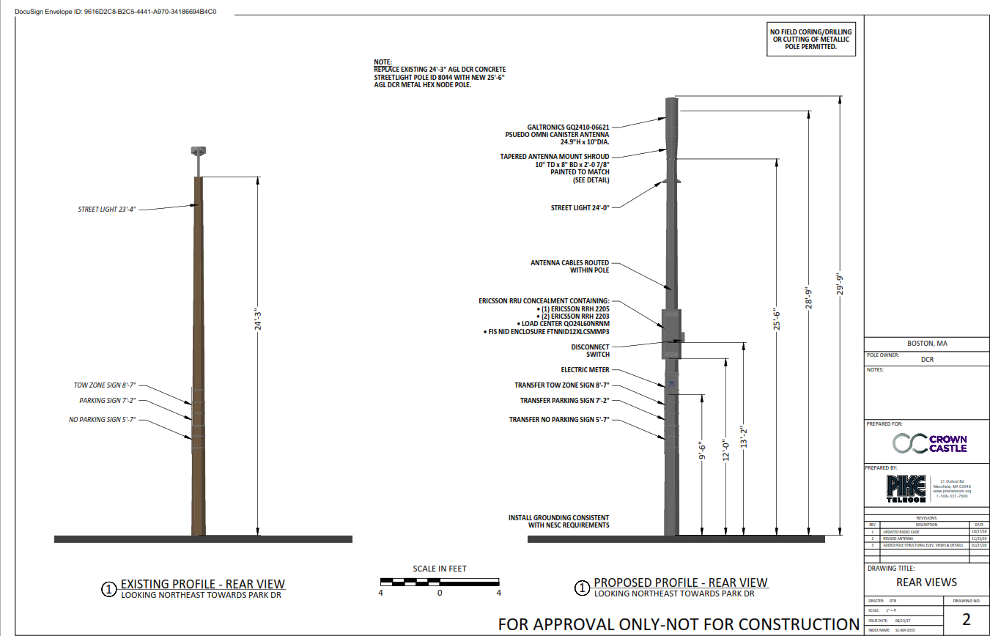

Slide 10
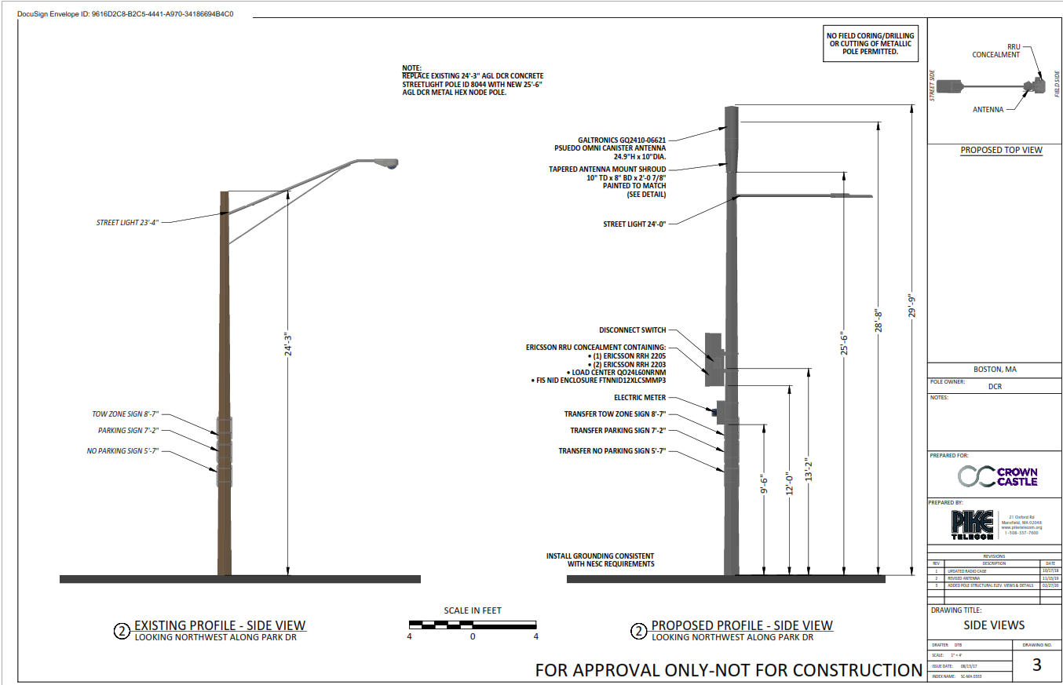

Slide 11
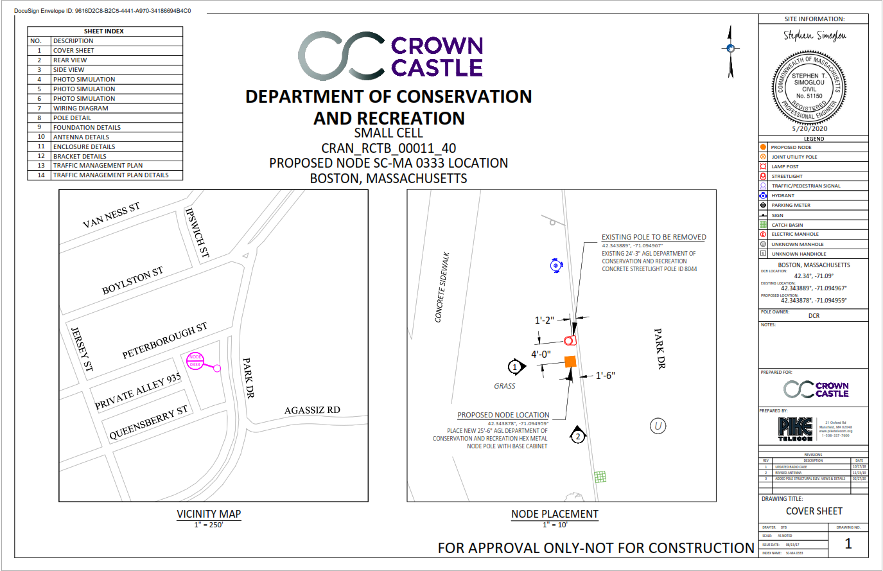

Slide 12
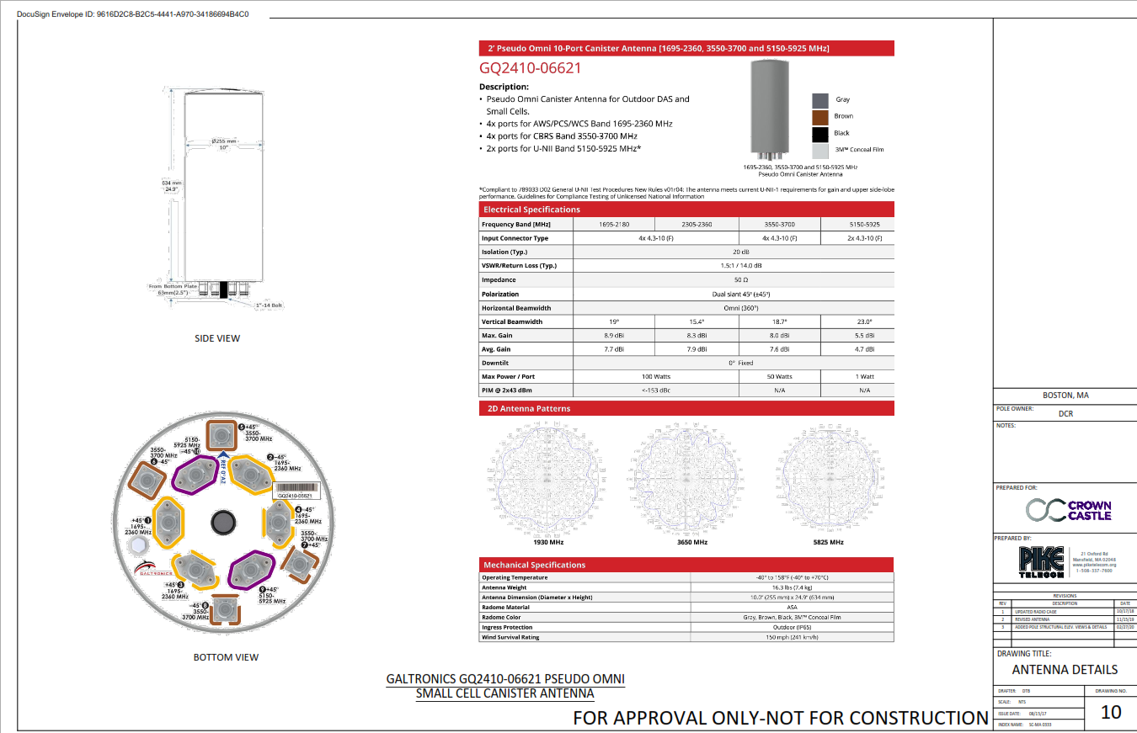

Slide 13
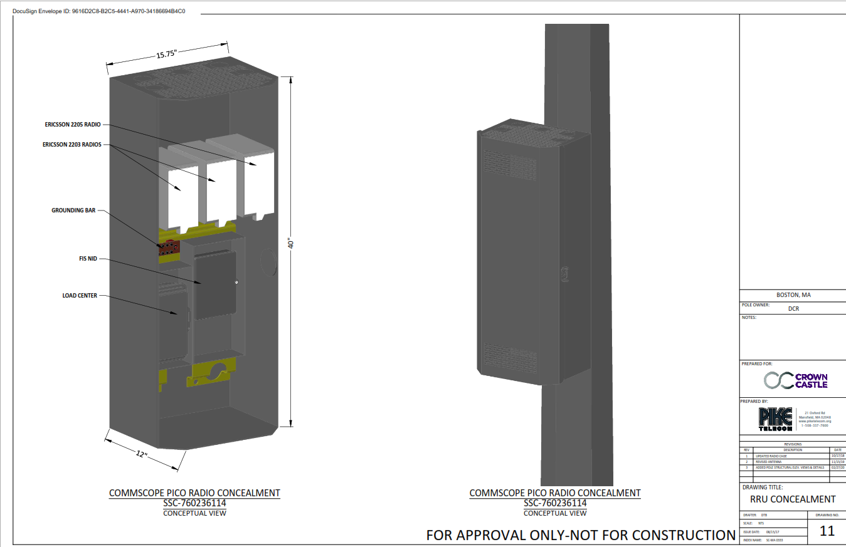

Slide 14
