Slide 1
BOSTON UNIVERSITY Bay State Road/Back Bay West Architectural Conservation District
Dahod Family Alumni Center
225 Bay State Road
Signage Proposal

Slide 2
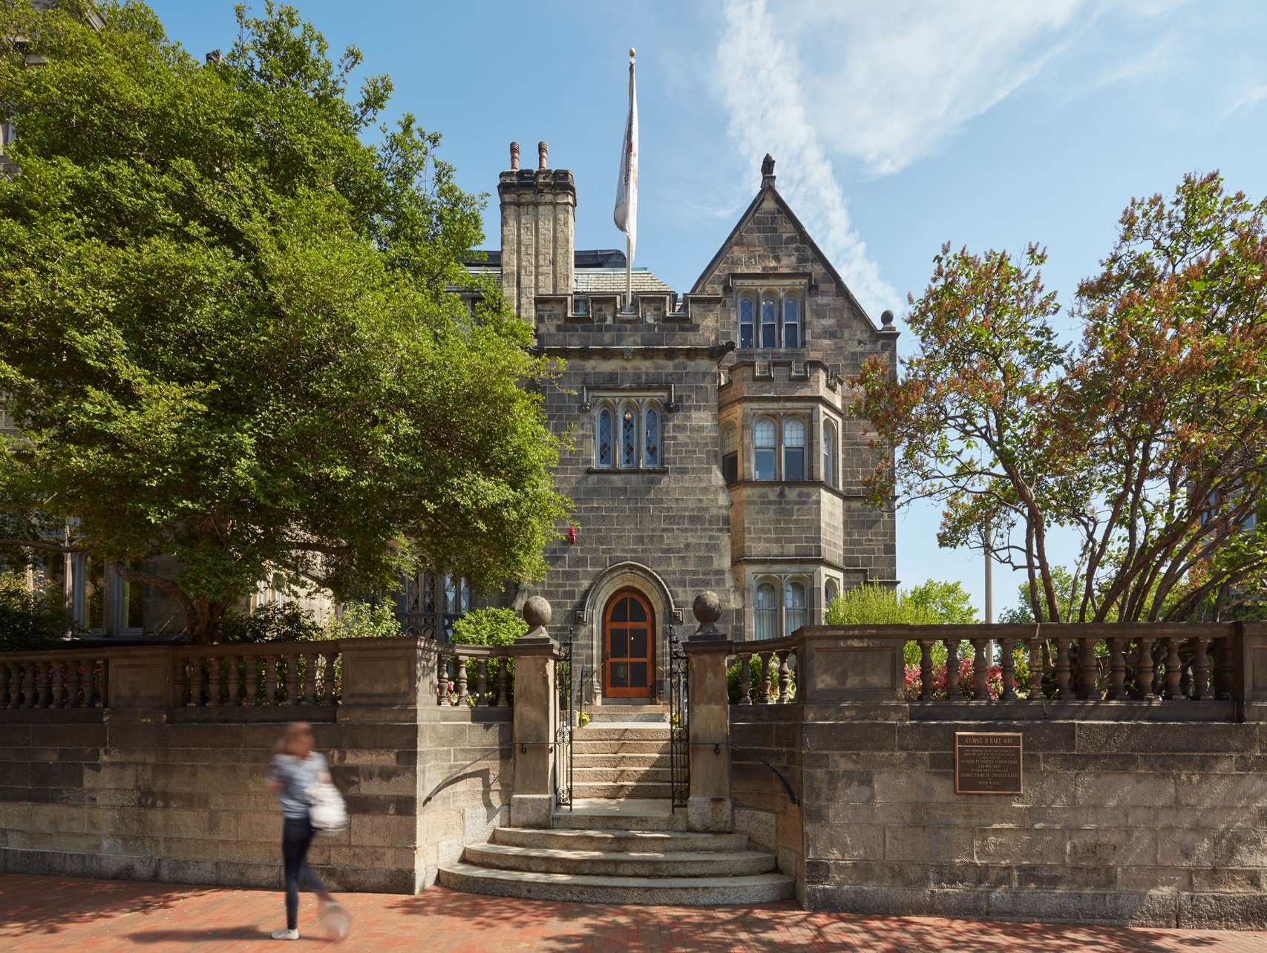
Alumni Center – Existing Conditions – Bay State Road
Under construction – slated for opening September 2018
Complete Exterior restoration
Accessibility and life safety upgrades

Slide 3
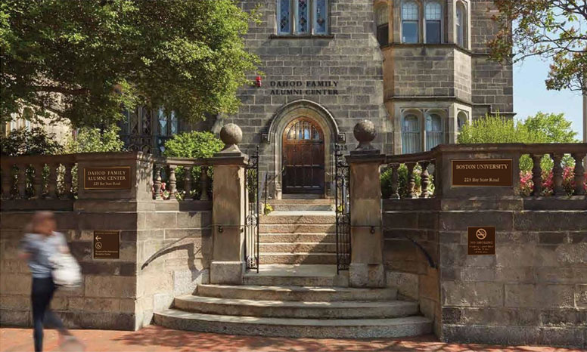
Alumni Center – Proposed Building Name - Bay State Road View
Dark bronze letterforms above existing front doorway
Bronze plaques, required accessibility and no smoking signage at front retaining wall steps

Slide 4
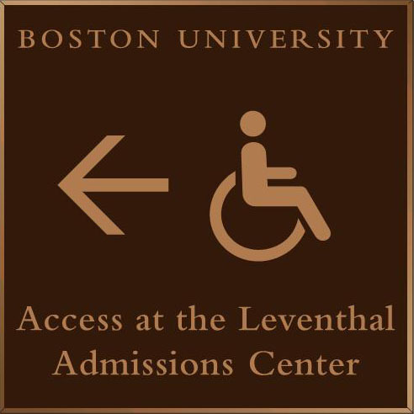
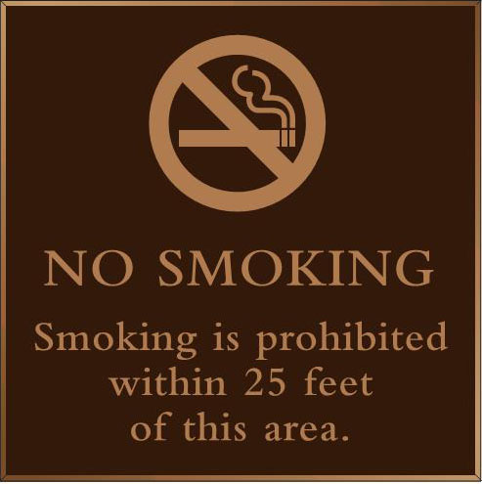
Alumni Center – Proposed signs at Bay State Road - Details
Access sign required as condition of MAAB Variance
No Smoking sign required for LEED Gold Certification
Signs are 12”x12”
Signs are cast bronze plaques. Dark oxidixed bronze background, satin polished edges

Slide 5
Alumni Center – Proposed signs at Bay State Road - Details
Sign is approximately 10” x 19” – will be fit to existing stone pier with visual edge of pier detail visible
Signs is cast bronze plaque. Dark oxidixed bronze background, satin polished edges

Slide 6
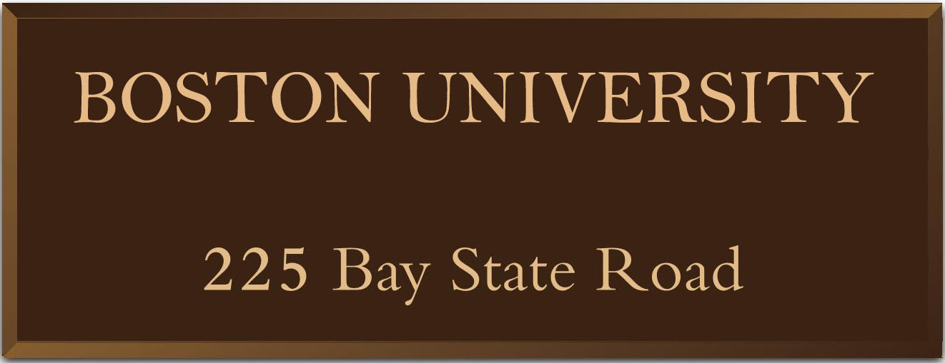
Alumni Center – Proposed signs at Bay State Road - Details
Sign is approximately 10” x 19” – will be fit to existing stone pier with visual edge of pier detail visible
Signs is cast bronze plaque. Dark oxidixed bronze background, satin polished edges

Slide 7
Alumni Center – Proposed Building Name – Letterform Details
Front entryway letters are 5” high
Total coverage of letters is approximately 16” high x 72” wide
Letters are dark oxidized bronze, 1/2” thick
Letters are post mounted into stone with silicone – this installation method has been approved by the building conservator

Slide 8
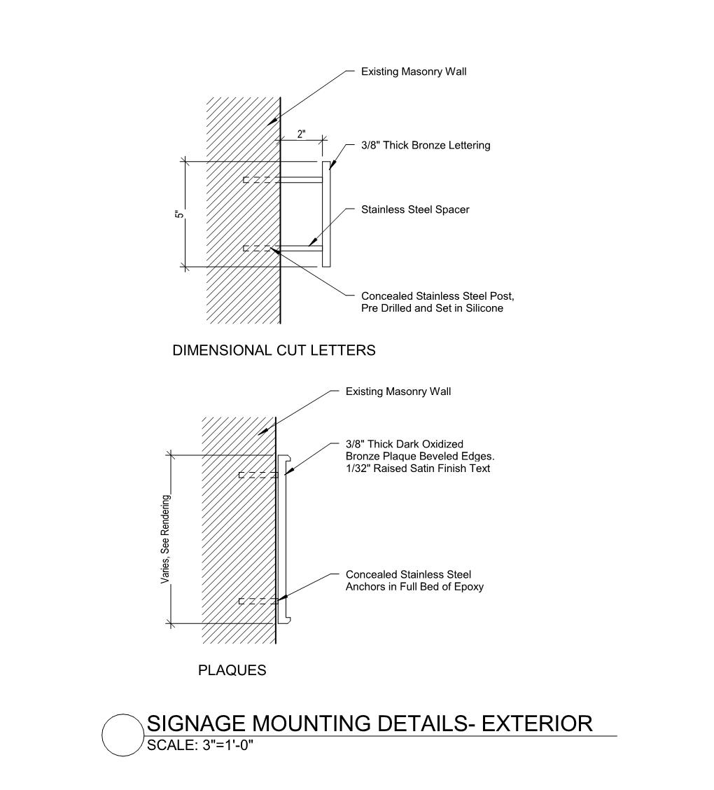
Alumni Center – Proposed Signage Mounting Methods

Slide 9
Alumni Center – Relocated George D. Hart Way Sign
Existing George D. Hart Way sign relocated to end of wall along Bay State Road

Slide 10
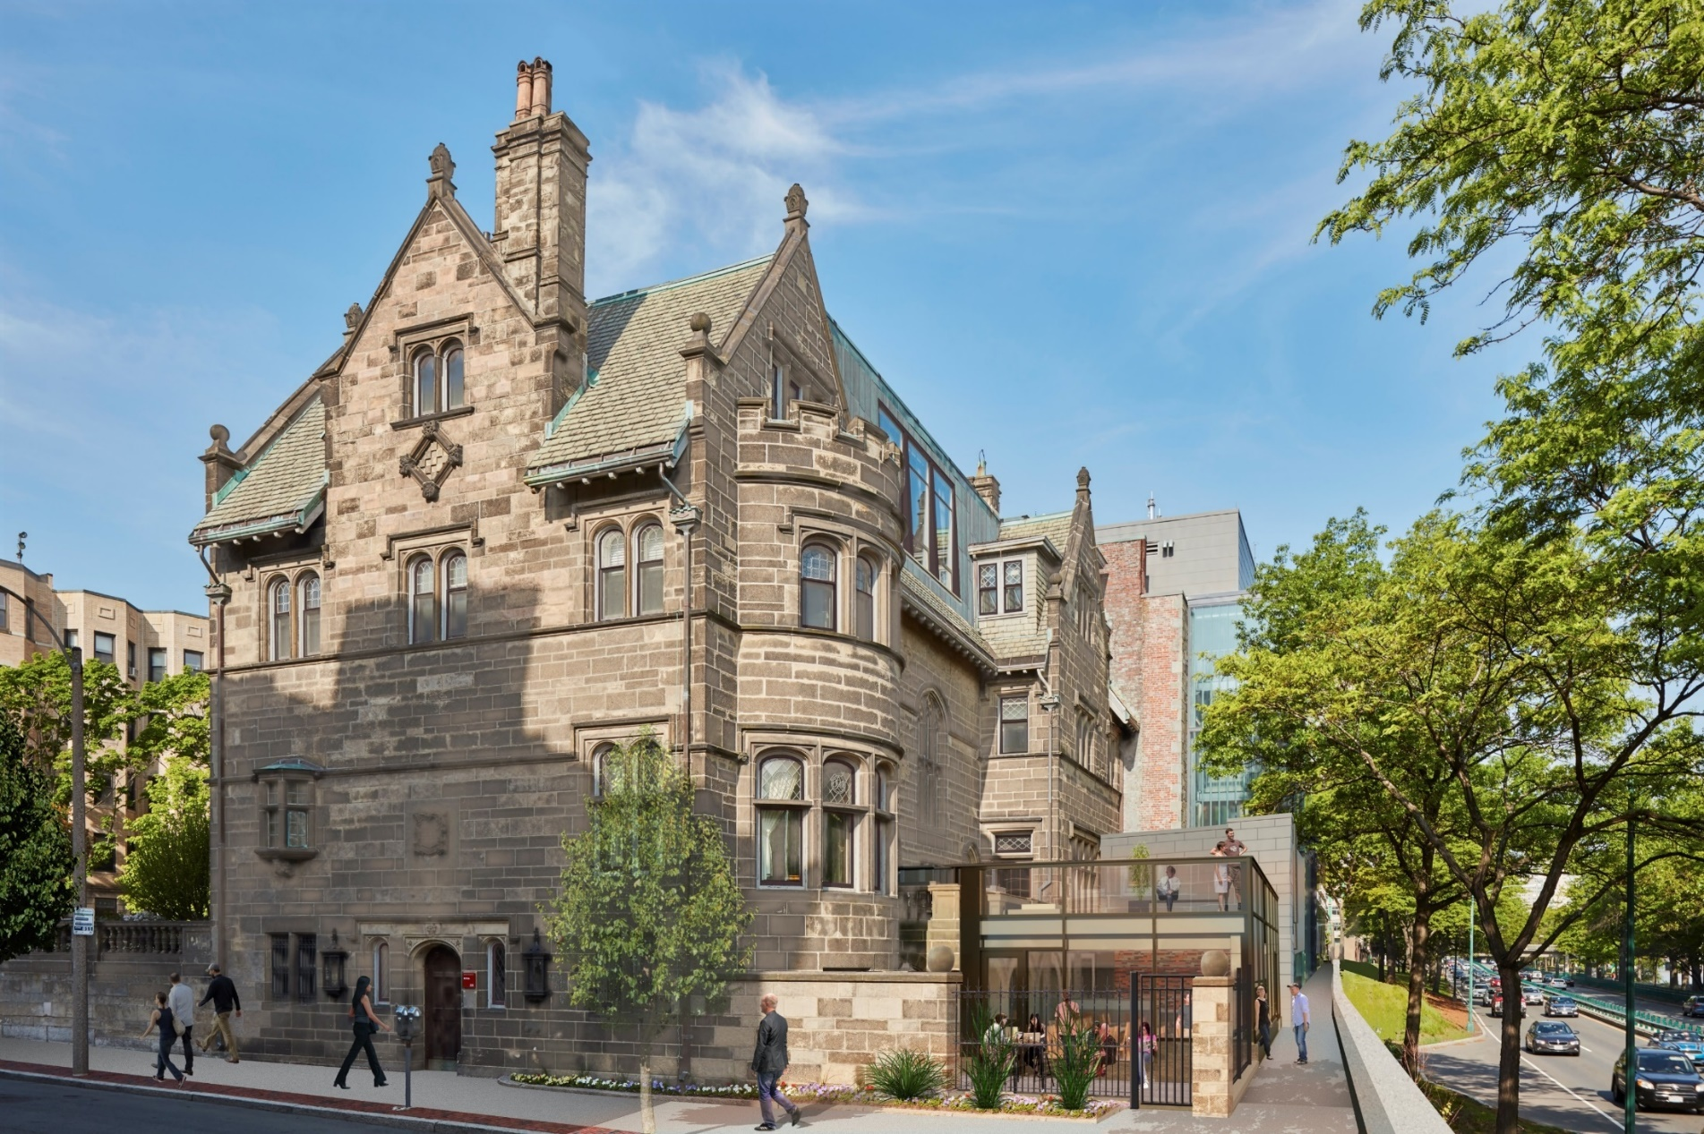
Alumni Center – Proposed Granby Street View

Slide 11
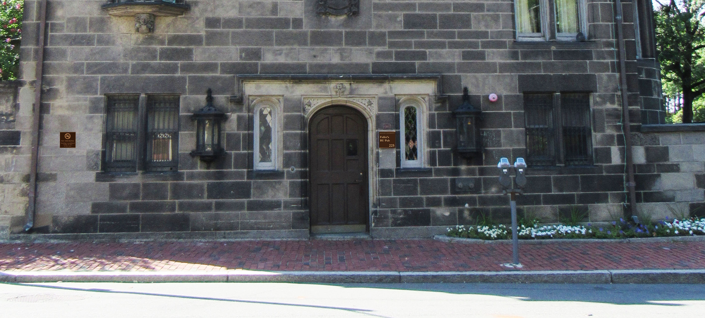
Alumni Center – Granby Street Proposed Signage
No change Pub Sign location
No Smoking sign same materials and dimensions as No Smoking sign on Bay State Road

Slide 12
Alumni Center – Pub Entry Existing Signage – Granby Street View
Standard BU red signage

Slide 13
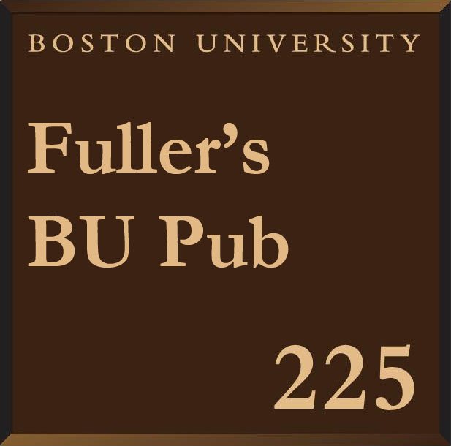
Alumni Center – Pub Entry Existing vs. Proposed Signage
Standard BU Red signage to be replaced with new bronze plaque signage
Sign is 12” x 12”

Slide 14
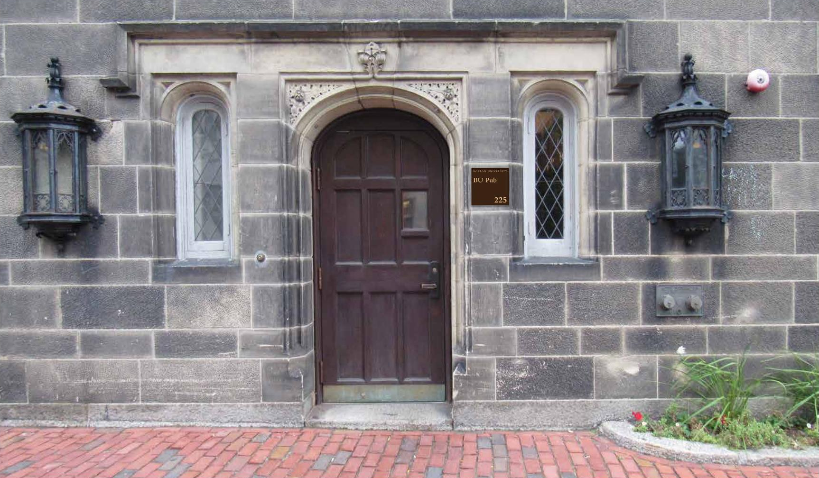
Alumni Center – Pub Entry Proposed Signage – Granby Street View
No change to location
New bronze sign – same size as existing

Slide 15
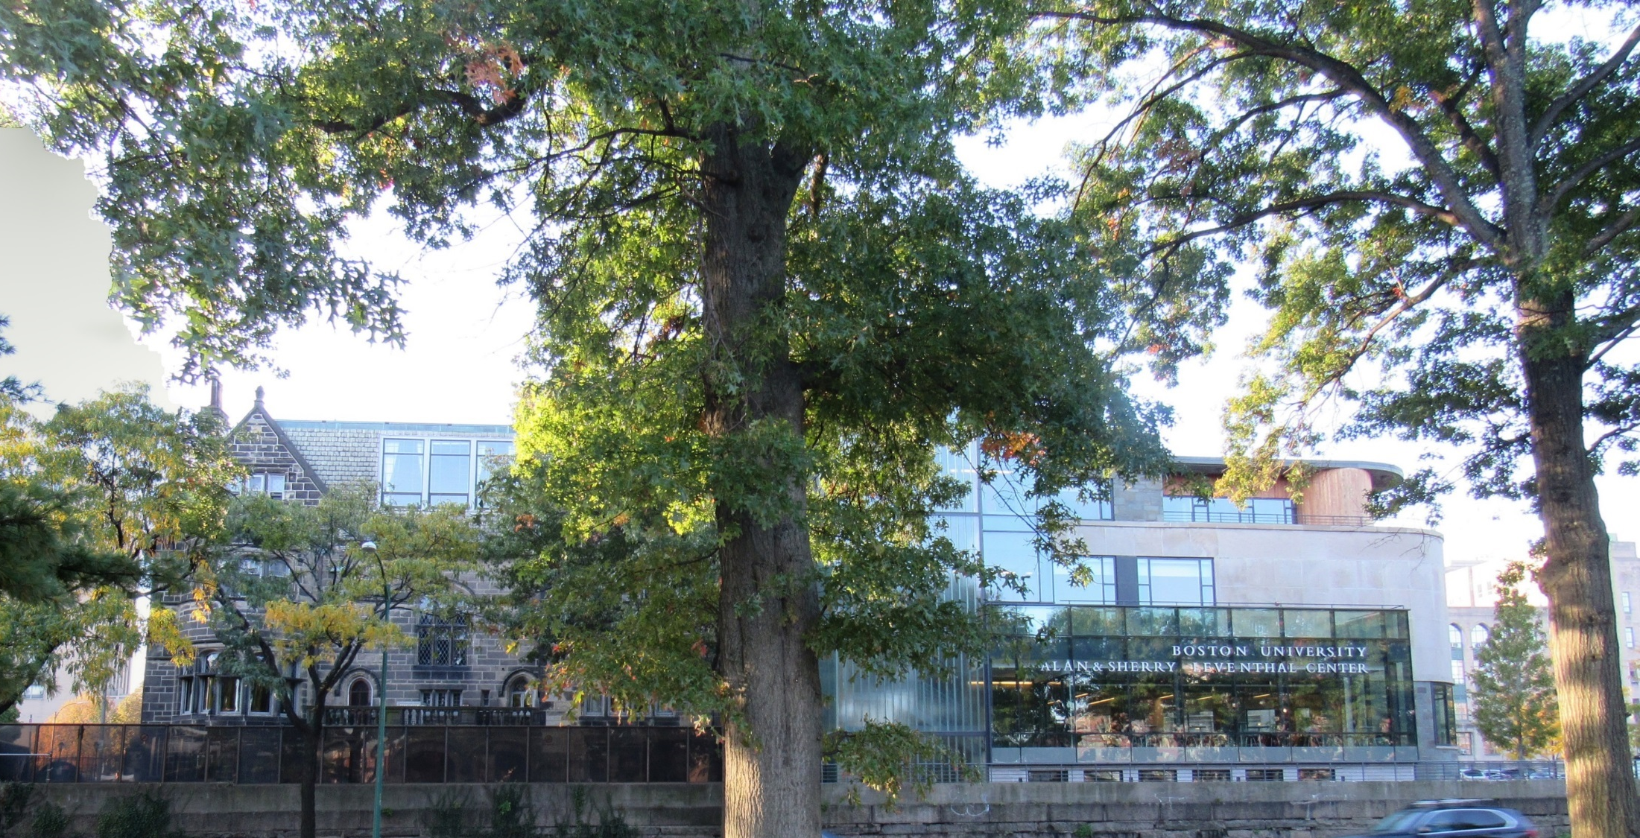
Alumni Center – Existing Conditions – Storrow Drive

Slide 16
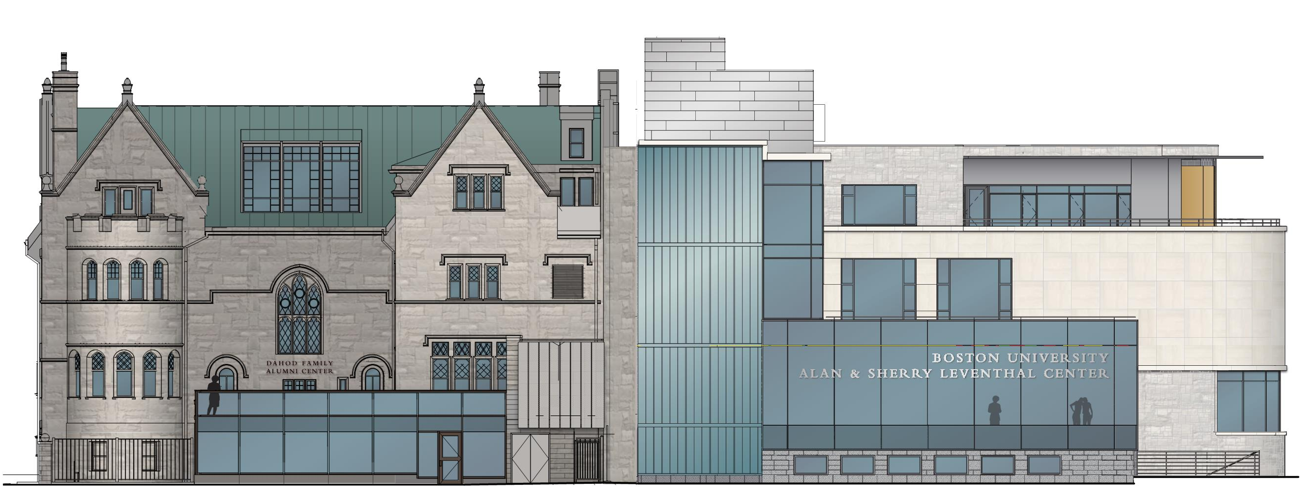
Alumni Center – Proposed building name – Storrow Drive
Bronze letterforms below major window

Slide 17
Alumni Center – Proposed Building Name – Letterform Details
Rear wall mounted letters are 5” high
Letters are dark oxidized bronze, 1/2” thick
Total coverage of letters is approximately 12” high and 72” wide
Letters are post mounted into stone with silicone – this installation method has been approved by the building conservator

Slide 18
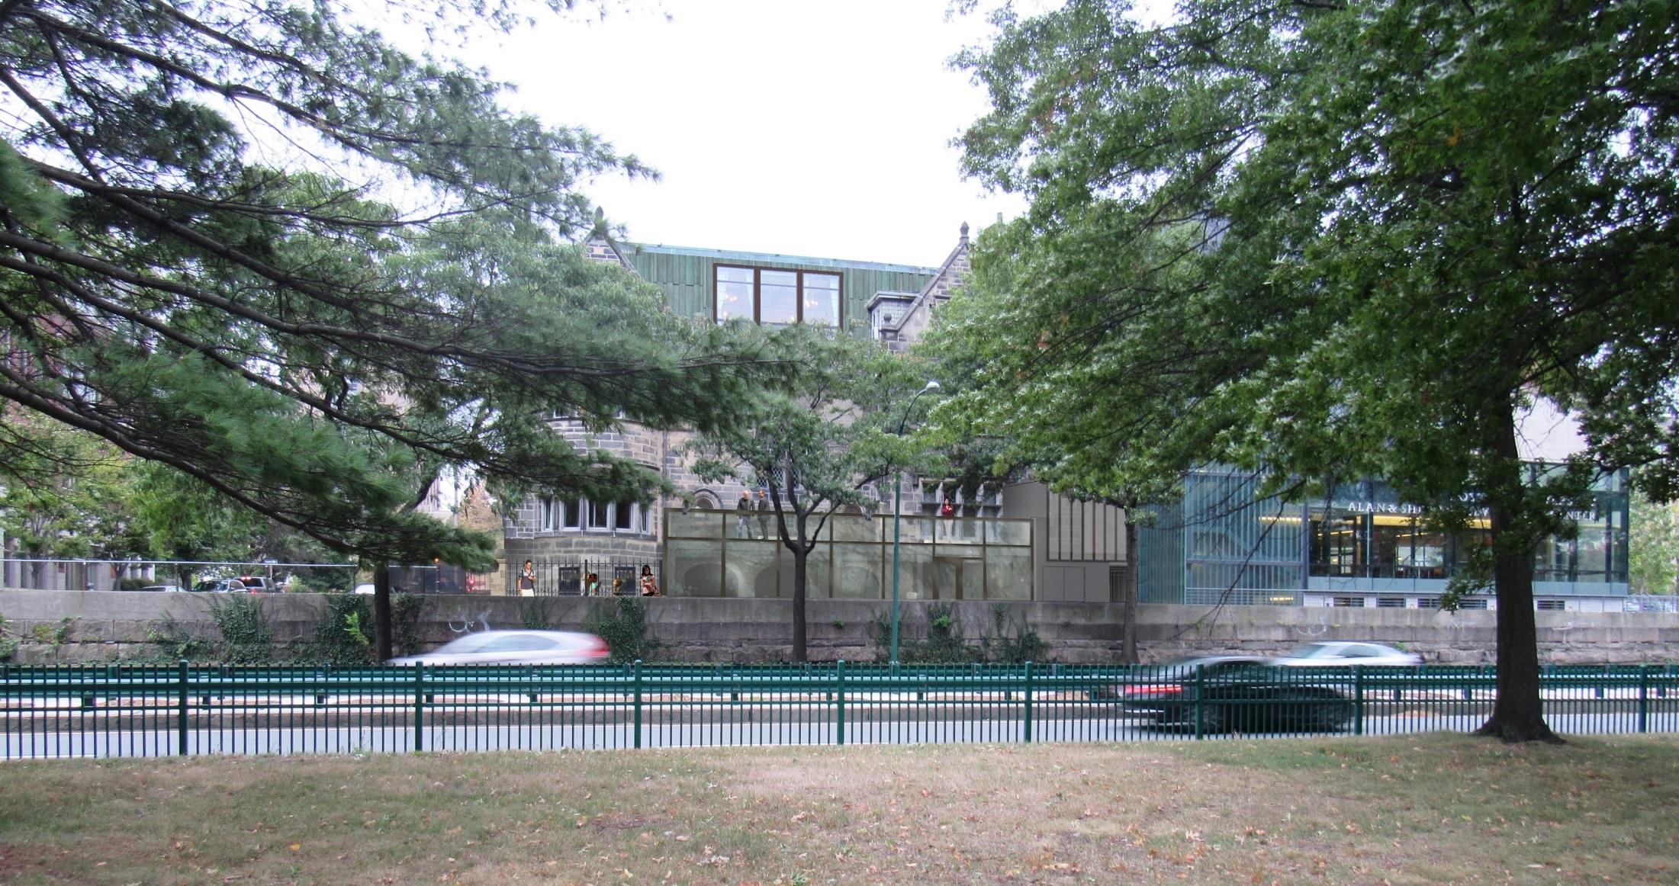
Alumni Center – Proposed Conditions – Storrow Drive
Visibility Extremely Limited

Slide 19
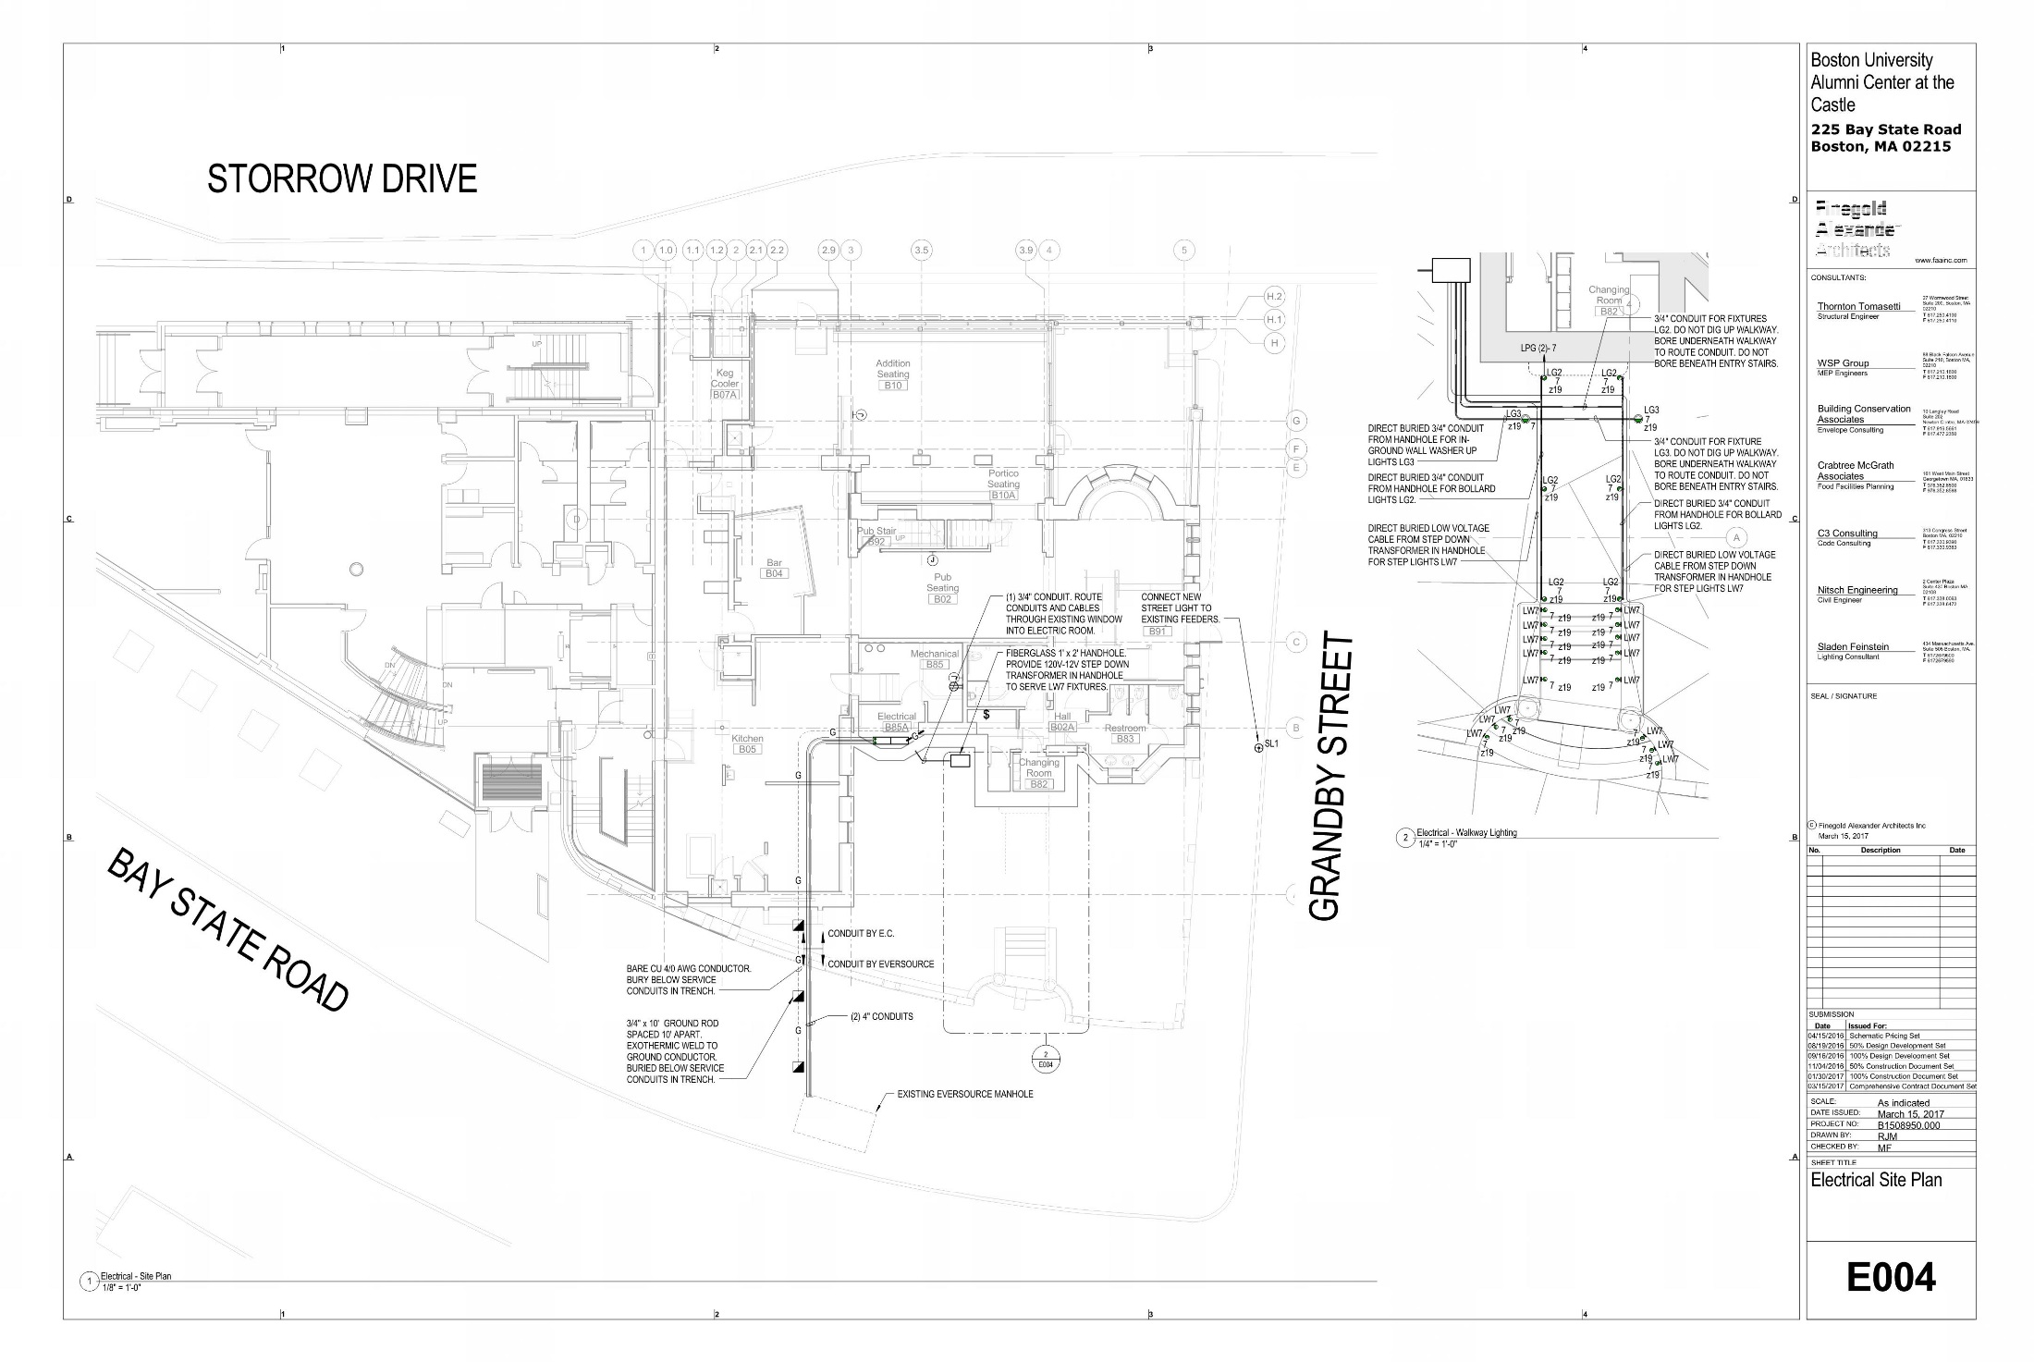
Alumni Center – Proposed Conditions – Site Lighting
Code required Egress Path Lighting

Slide 20
Alumni Center – Proposed Conditions – Site Lighting
Front Entry
LG2 Designation indicates pathway bollard
LW7 Designation indicates step light designation

Slide 21
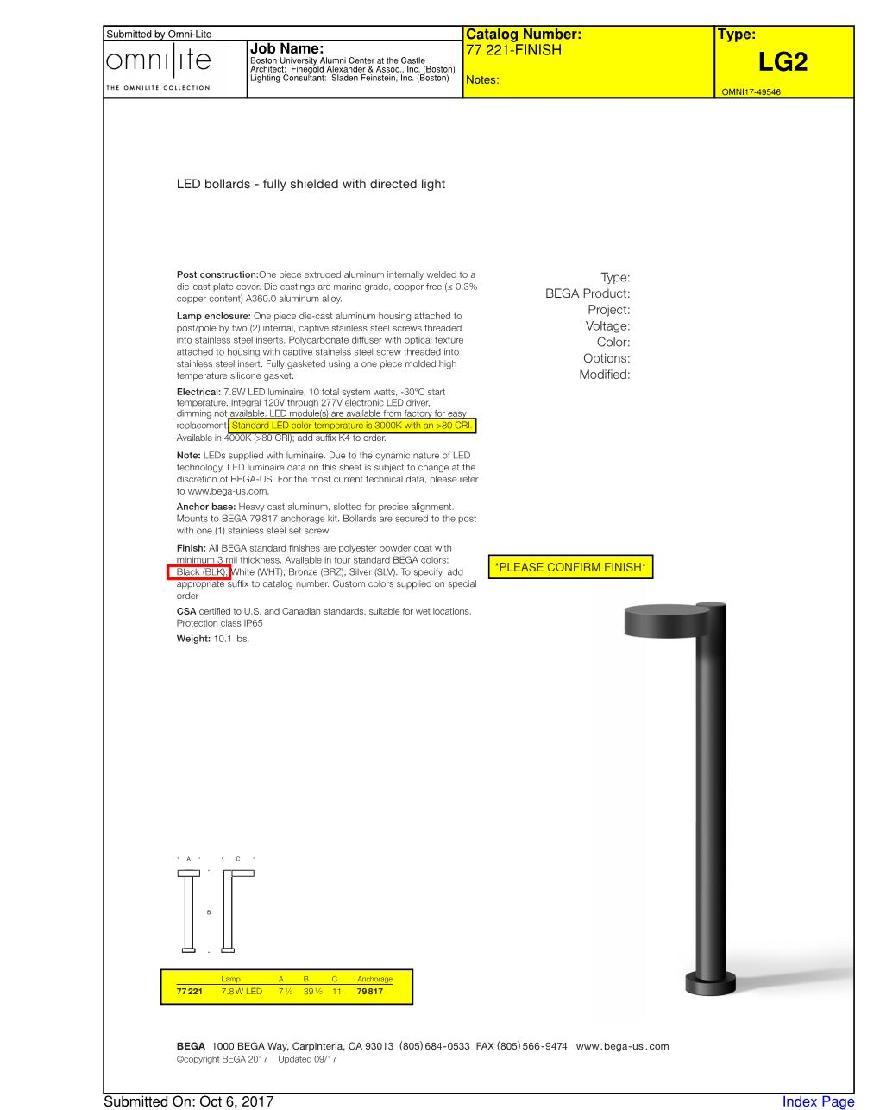
Alumni Center – Proposed Conditions – Site Lighting
Bollards at Walkway

Slide 22
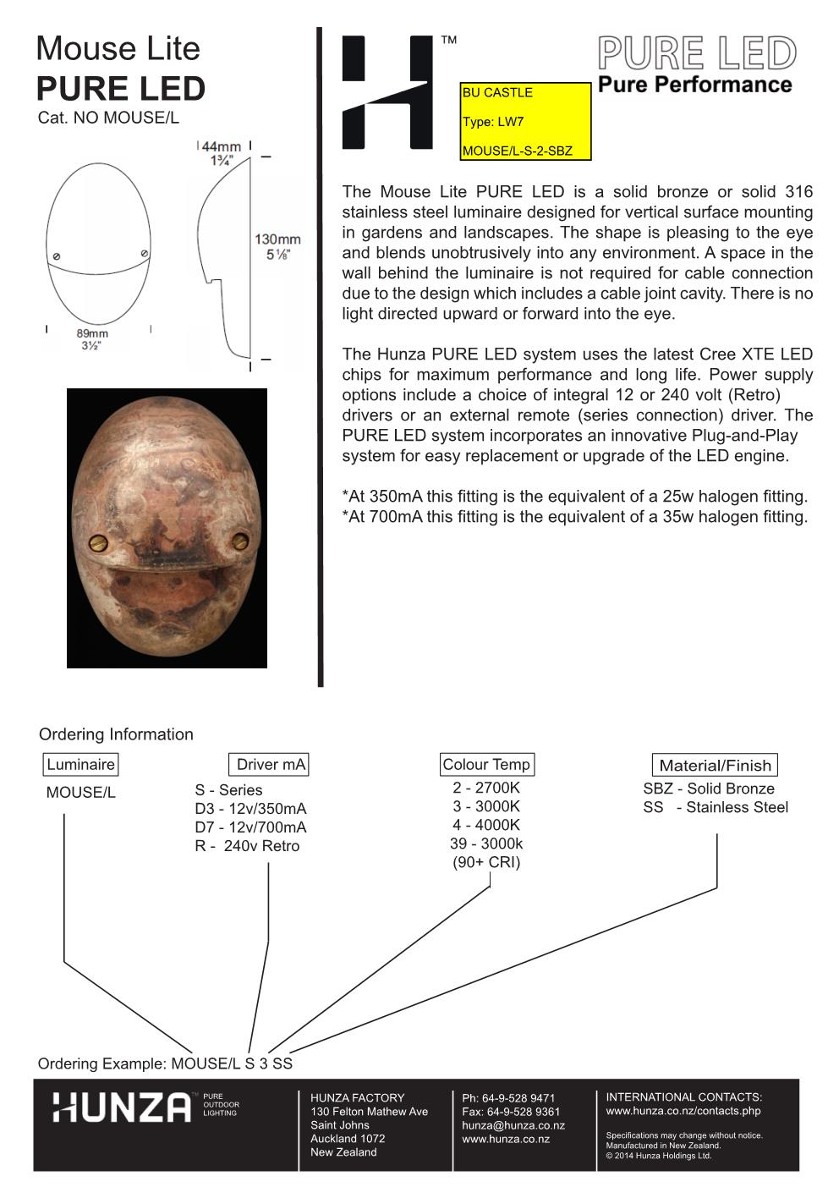
Alumni Center – Proposed Conditions – Site Lighting
Step Lights

