Slide 1
Welcome to the Conversation!
Thursday June 6, 2019
Community Meeting
Regarding
Parcels on Hollander and Holworthy

Slide 2
Meeting Agenda
1. General Introduction
2. Introduction to the Department of Neighborhood Development
3. Introduction of Parcels
4. Introduction of Past Neighborhood Home Imitative Projects
5. Discussion of Best Use of Parcels
6. Next Steps

Slide 3
Department of Neighborhood Development
1. Neighborhood Housing Development
2. Office of Housing Stability
3. Real Estate Management Services
4. The Boston Home Center
5. Housing Innovation Lab

Slide 4
List of Parcels
Number | Parcel ID | Address | Sq. Footage
1 | 1203306000 | 80 HOLWORTHY ST | 3,334 sq ft
2 | 1203307000 | 78 HOLWORTHY ST | 3,333 sq ft
3 | 1203308000 | 76 HOLWORTHY ST | 3,333 sq ft
4 | 1203309000 | 74 HOLWORTHY ST | 3,333 sq ft
5 | 1203310000 | UNNUMBERED HOLWORTHY ST | 38,767 sq ft
6 | 1203326000 | 59 HOLLANDER ST | 3,250 sq ft
7 | 1203325001 | 57 HOLLANDER ST | 3,250 sq ft
8 | 1203320000 | 31 HOLLANDER ST | 3,300 sq ft
9 | 1203319000 | 29 HOLLANDER ST | 3,300 sq ft
10 | 120333500 | 73 HOLWORTHY ST | 3,333 sq ft
11 | 1203334000 | 71 HOLWORTHY ST | 3,333 sq ft
Total Sq. ft. |  |  | 71,866

Slide 5
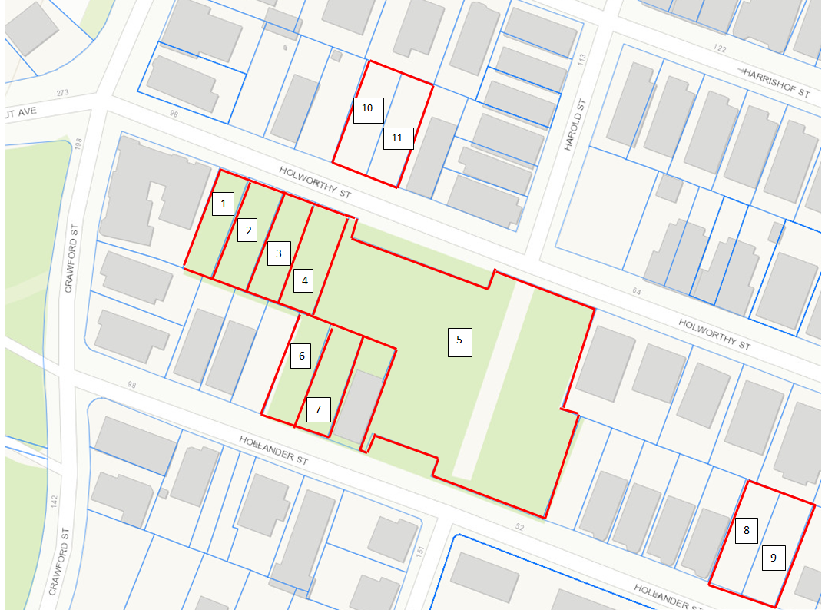
Parcel Map

Slide 6
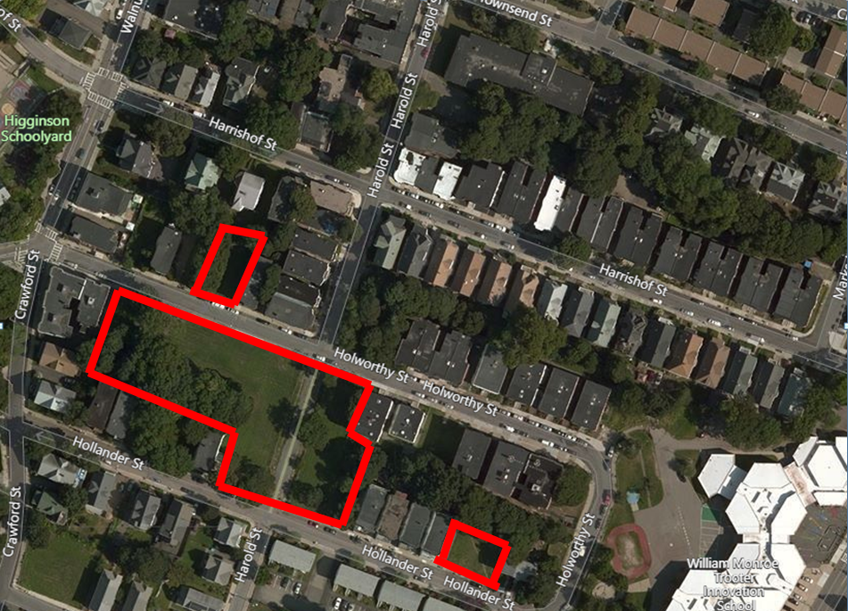
Aerial View

Slide 7
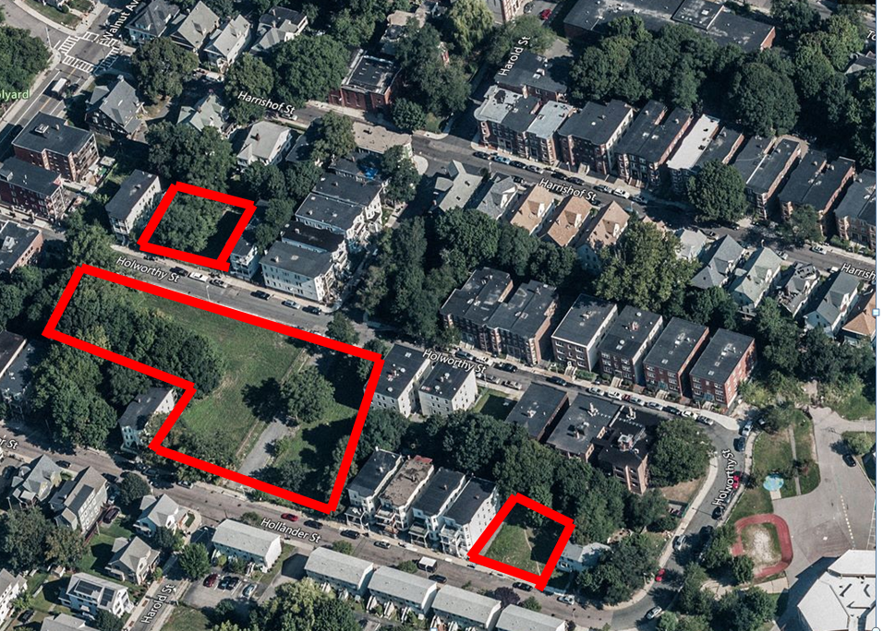
Bird’s Eye View

Slide 8
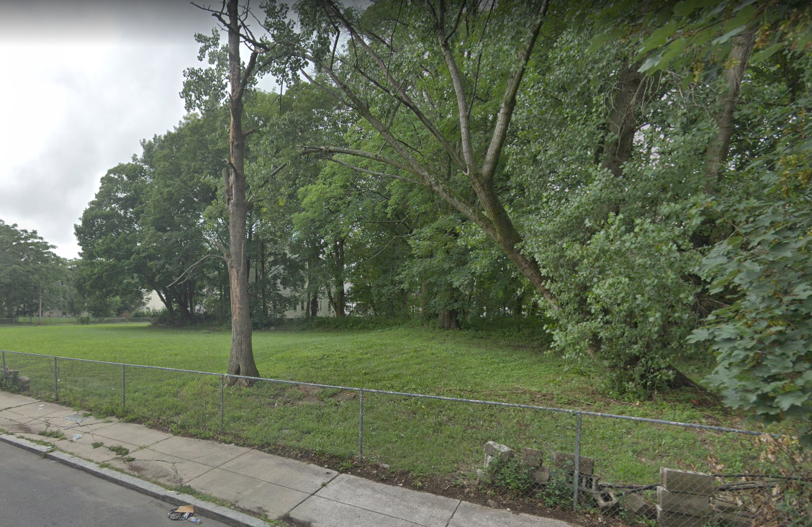
Holworthy Street View

Slide 9
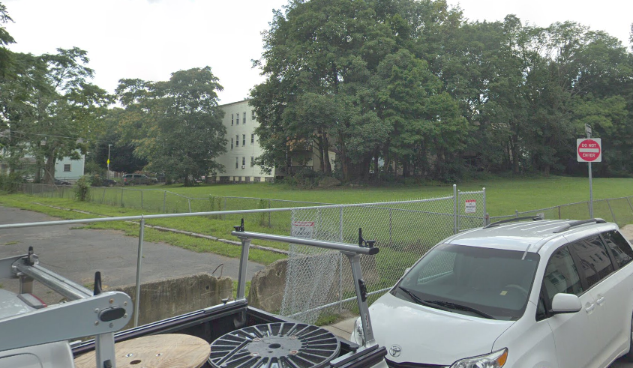
Holworthy Street View

Slide 10
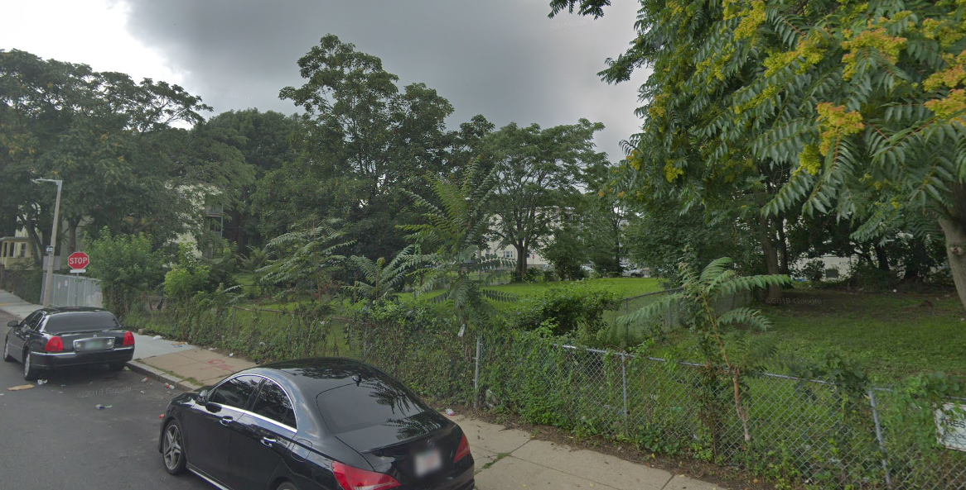
Hollander Street View

Slide 11
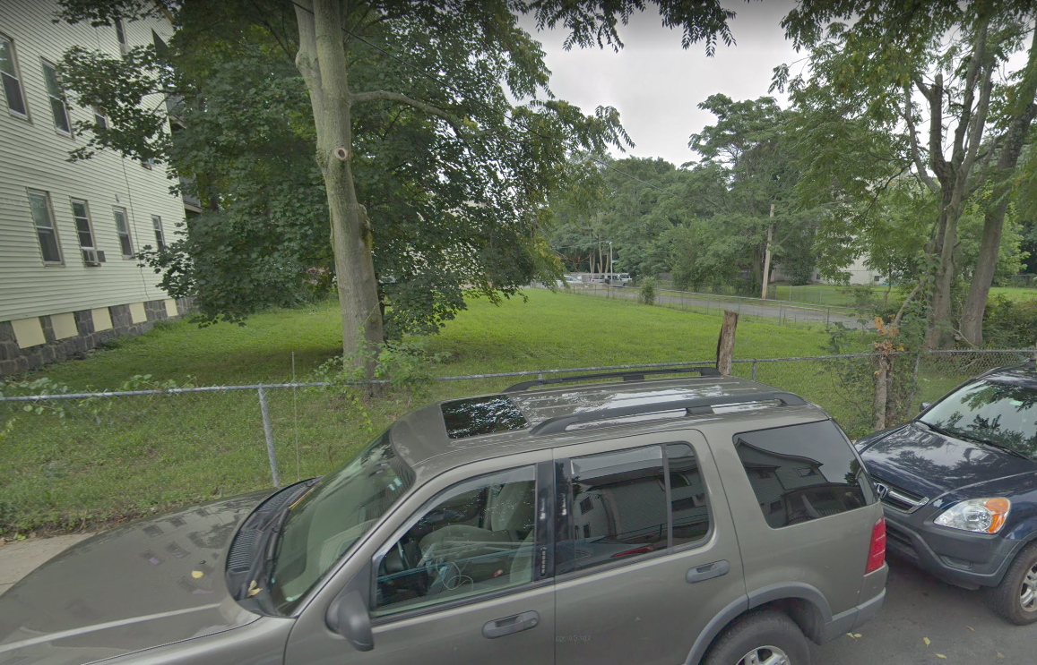
Hollander Street View

Slide 12
Past Neighborhood Home Intiative Projects

Slide 13
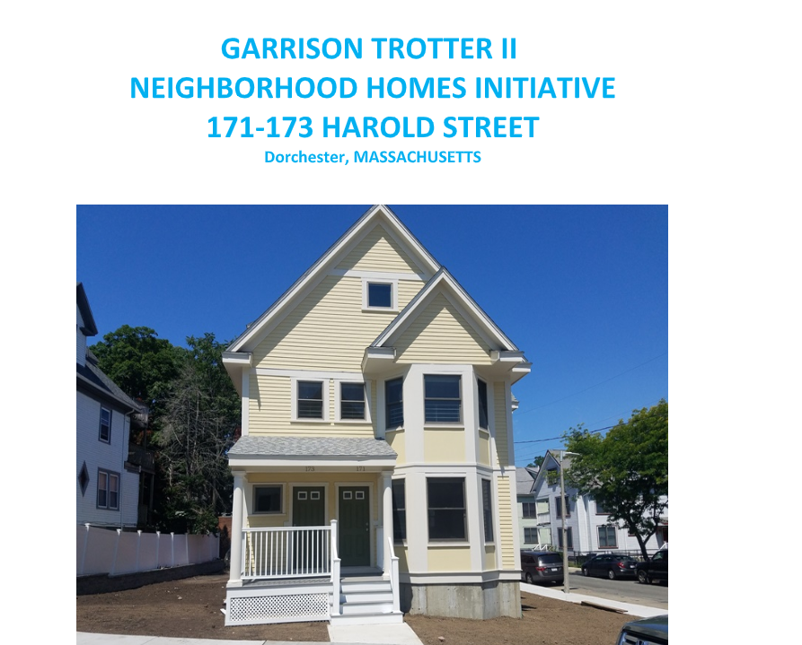

Slide 14
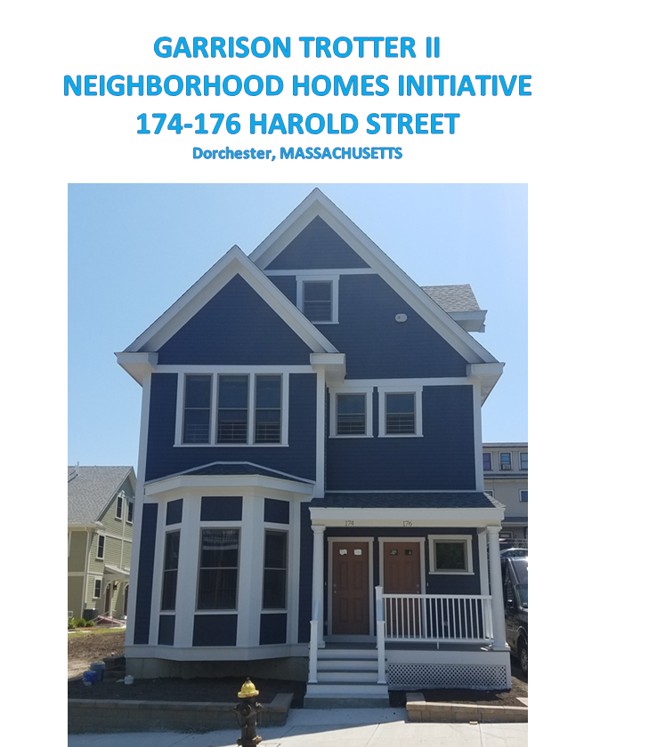

Slide 15
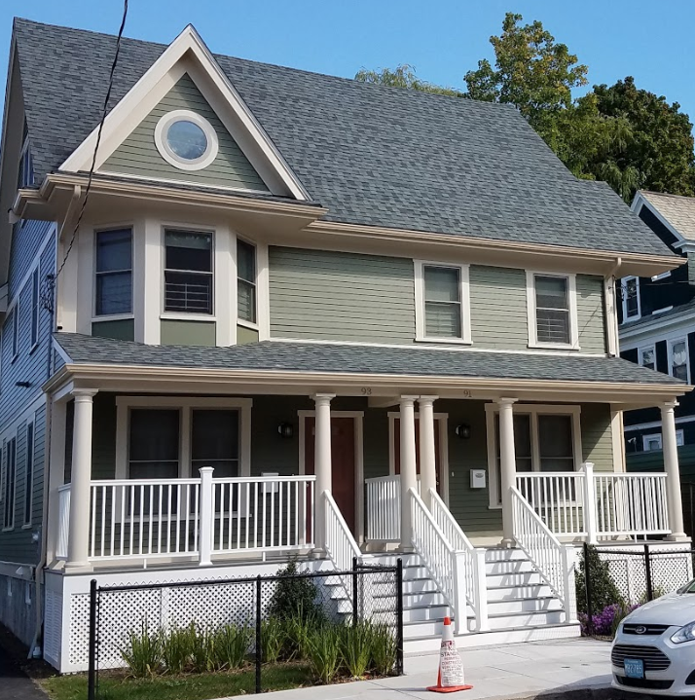
91 Waumbeck

Slide 16
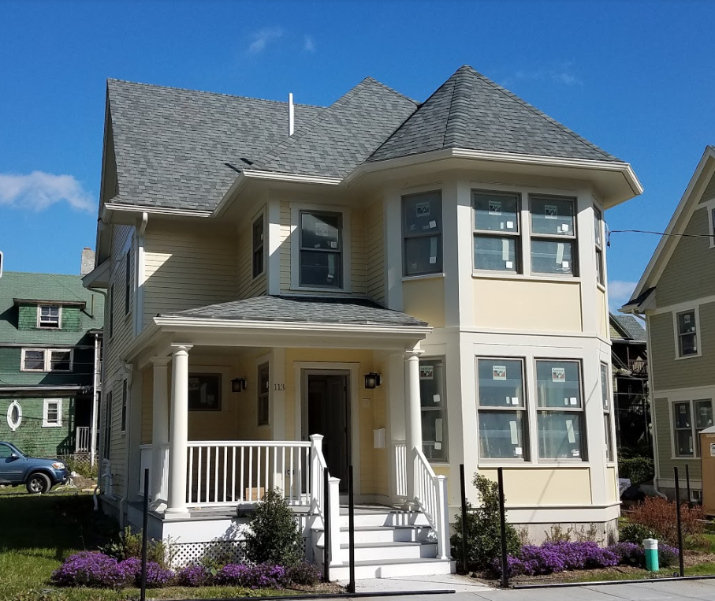
93 Waumbeck

Slide 17
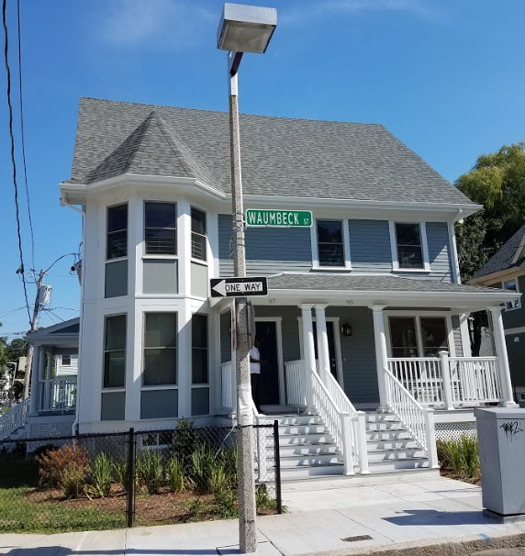
95-97 Waumbeck Street

Slide 18
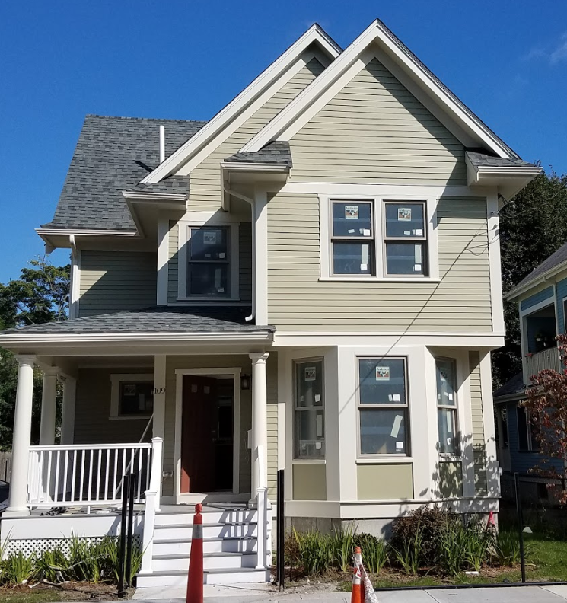
109 Waumbeck Street

Slide 19
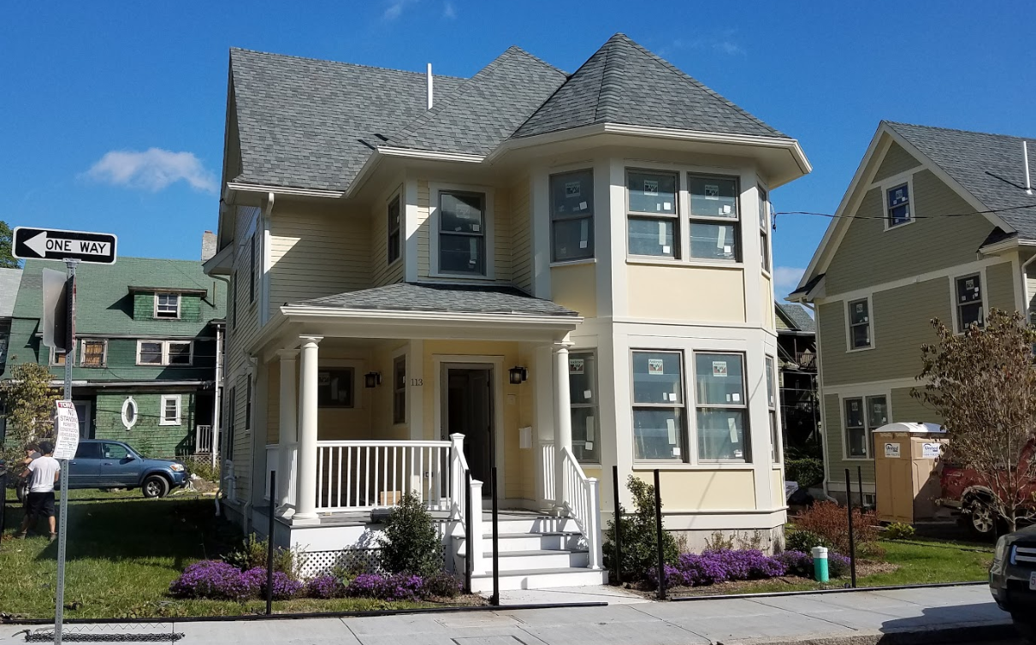
113 Waumbeck Street

Slide 20

Next Steps
COMMUNITY MEETING JUNE 6
COMMUNITY MEETING
TO DISCUSS HOME TYPES
RFP AVAILABLE
Initial community meeting to discuss site use.
Community Meeting to introduce schematic designs of housing

Slide 21
Questions?
Please Contact:
Jonathan Spillane, Development Officer, 617-635-0248, jonathan.spillane@boston.gove
John Feuerbach, Senior Development Officer,
617-635-0353, john.feuerbach@boston.gov

