Slide 1
Welcome to the Conversation!
Thursday, December 14, 2017
Curtis Hall
Community Meeting
regarding
79 Call Street, Jamaica Plain

Slide 2
AGENDA
Welcome & Introductions
Property Information
Discussion of the Development Guidelines
Next Steps
Adjourn

Slide 3
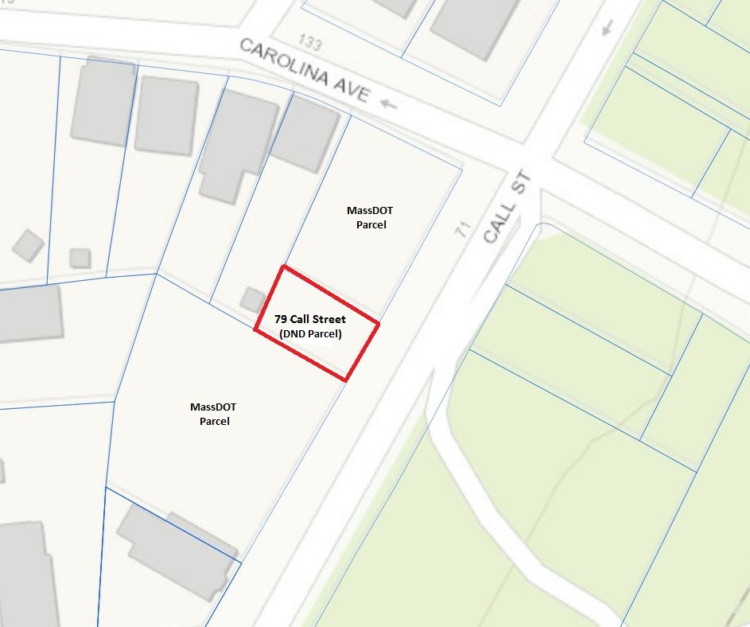
MAP of 79 Call Street, Jamaica Plain

Slide 4
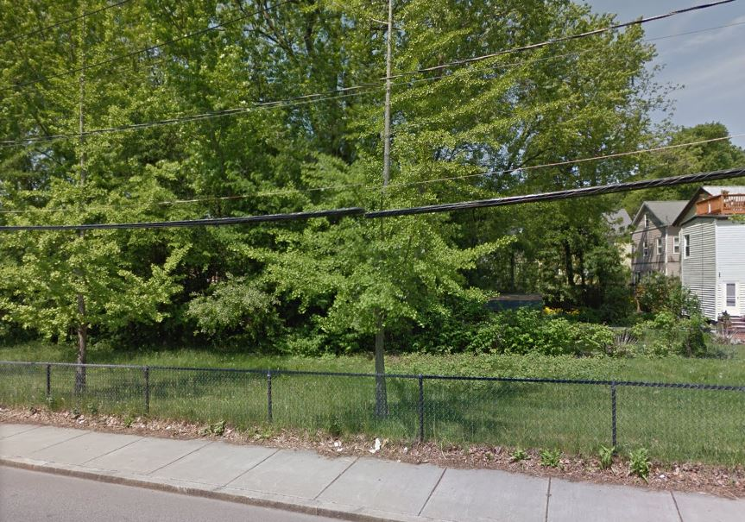
PHOTO of 79 Call Street, Jamaica Plain

Slide 5
PROPERTY INFORMATION
Address Ward Parcel # Lot Size
79 Call Street, 11 03041000 1,380 square feet
Jamaica Plain
The parcel has been in the City of Boston’s real estate inventory for 42 years. Acquired through property tax foreclosure on 7/28/1975.

Slide 6
PROPERTY INFORMATION
Zoning
District : Jamaica Plain Neighborhood
Sub-District : 3F-5000
(Residential Use: Maximum of three units per parcel. Minimum 5,000 square foot lot size.)
Overlay : None
Other Layers : Parks Design Review (Construction projects need to be reviewed by Boston Parks & Recreation.)

Slide 7
79 Call Street, Jamaica Plain
DISCUSSION

Slide 8
NEXT STEPS
DND will use the feedback from this meeting, as well as comments submitted until January 2nd, 2018, to draft the development guidelines to be used in the Request For Proposals (RFP).
To Comment On-Line, please visit our website at
buildinghousing.boston.gov
The 79 Call Street project page is
https://buildinghousing.boston.gov/project/79-call-street-jp-f8b74

Slide 9
CONTACT INFORMATION
Christopher Rooney
William Epperson
Donald Wright
Development Officer
Real Estate Management
& Sales
Phone: 617-635-0493
Email: christopher.m.rooney
@boston.gov
Assistant Director
Real Estate Management
& Sales
Phone: 617-635-0498
Email: william.epperson
@boston.gov
Deputy Director
Real Estate Management
& Sales
Phone: 617-635-0398
Email: donald.wright
@boston.gov

Slide 10
THANK YOU for Attending!
To Comment On-Line, please visit our website at
buildinghousing.boston.gov
The 79 Call Street project page is
https://buildinghousing.boston.gov/project/79-call-street-jp-f8b74

